Slide 1

AXON
DRAFT
One
A Dummies Guide to
AI in Police Report Writing

Slide 2

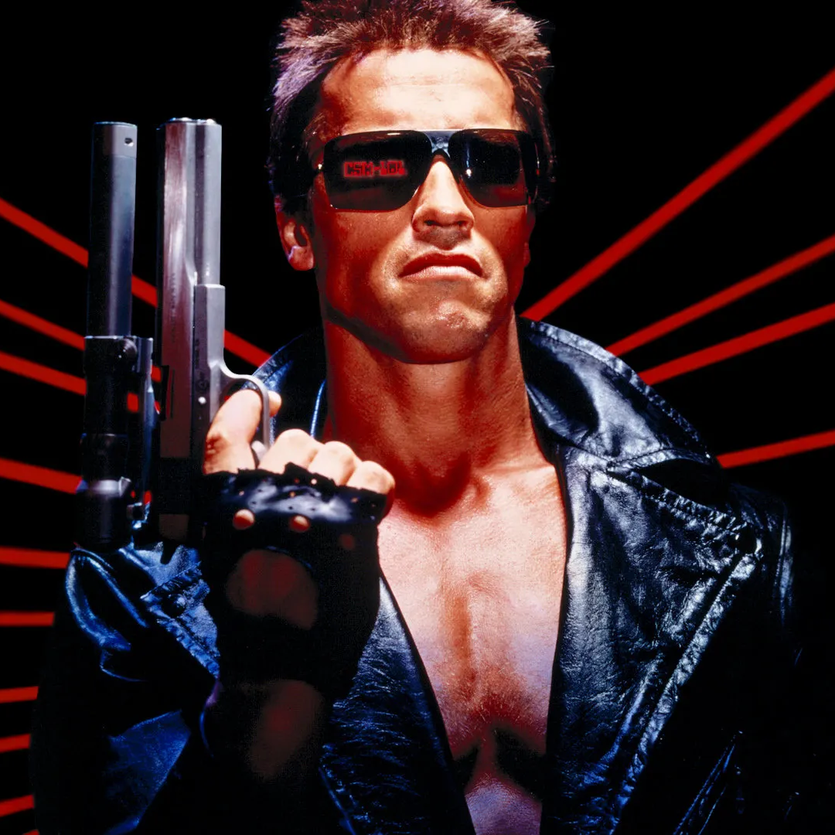
Artificial intelligence:

Slide 3

Reasons for axon draft one…..

Slide 4
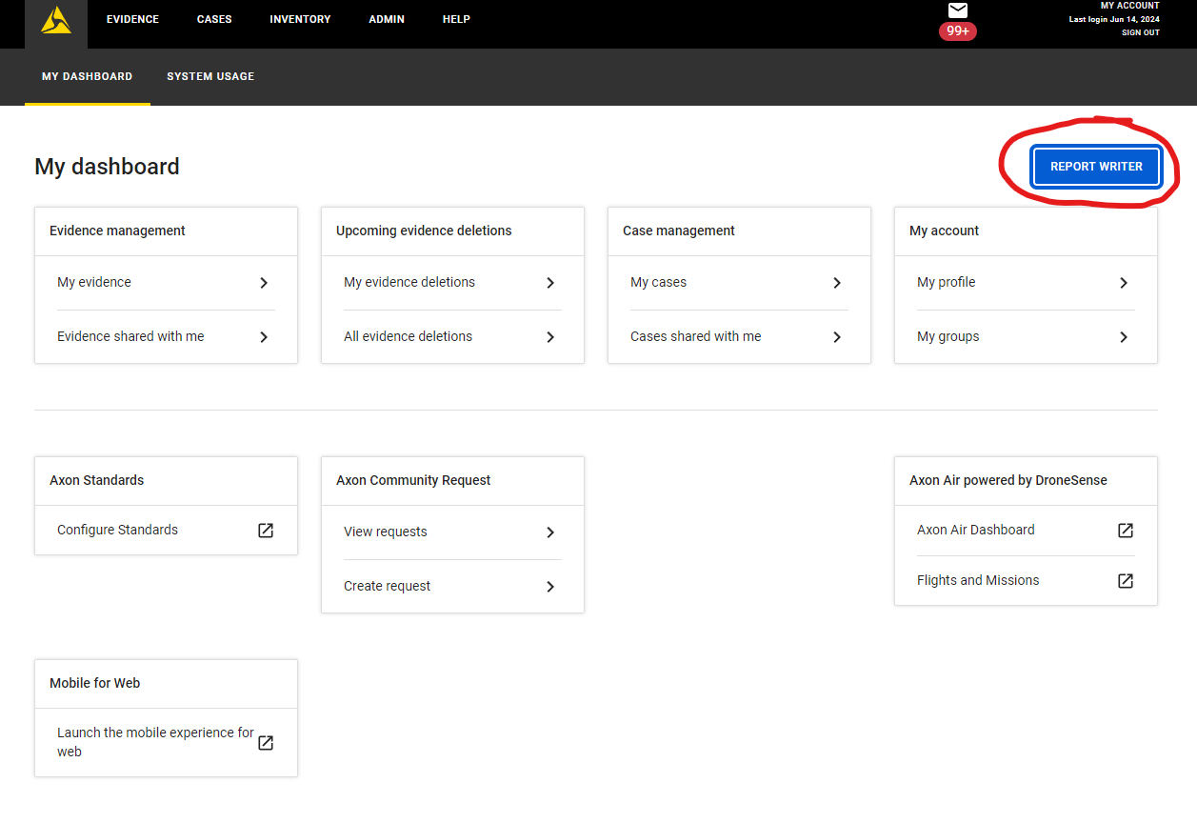
Let’s Get Started….

Slide 5
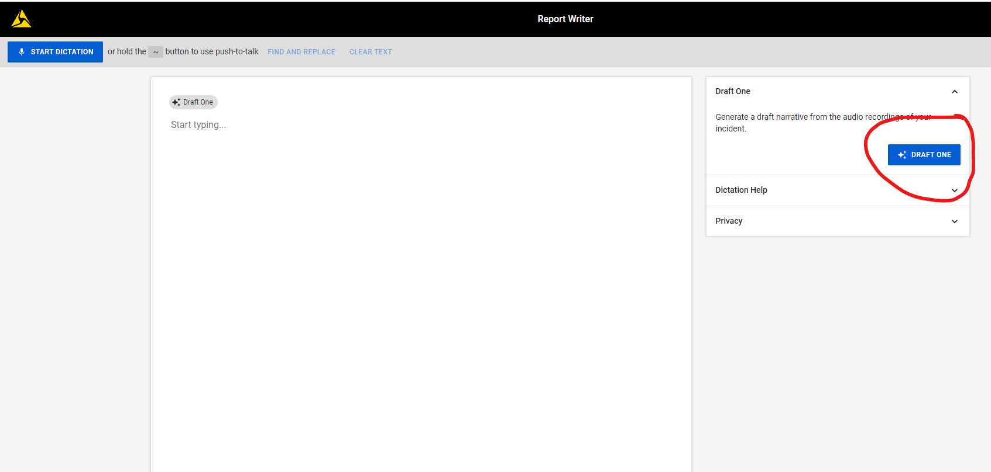
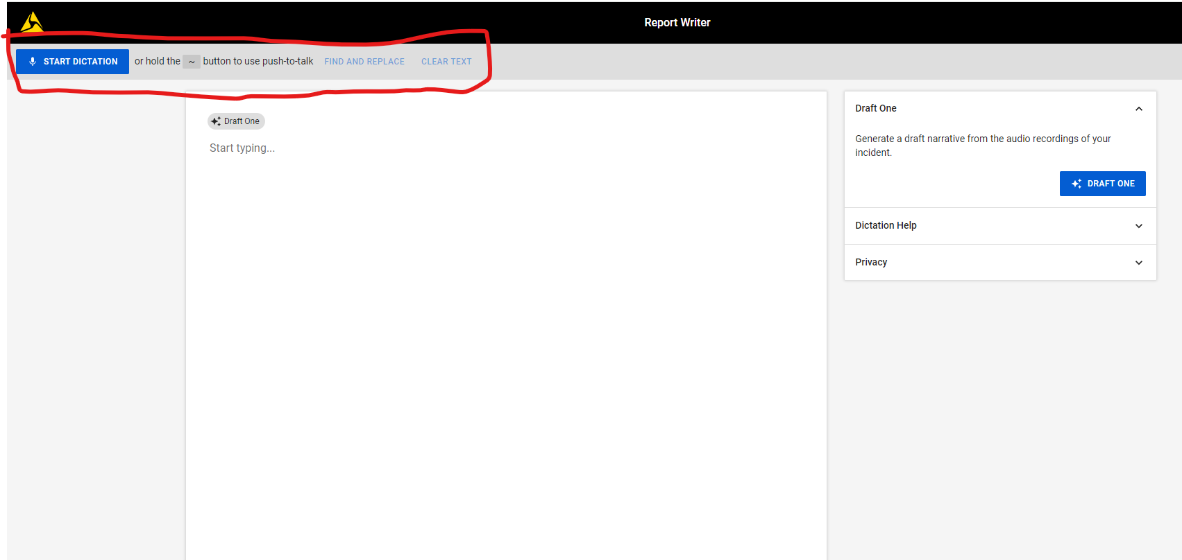
CLICK THE “DRAFT ONE” BOX
TO GENERATE A DRAFT NARRATIVE FROM BWC AUDIO
YOU DO HAVE THE OPTION TO DICTATE YOUR REPORT INTO DRAFT ONE -----------→

Slide 6
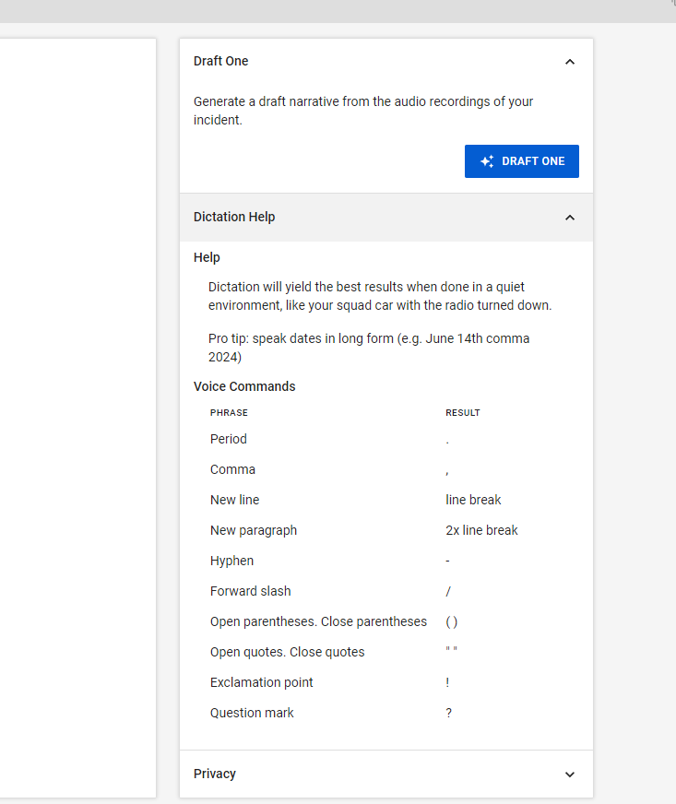
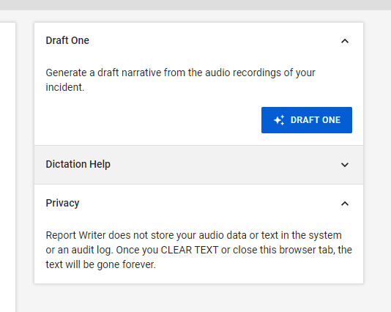
YOU WILL LOSE YOUR WORK IF YOU CLOSE OUT OF DRAFT ONE
DICTATION HELP/ TIPS

Slide 7
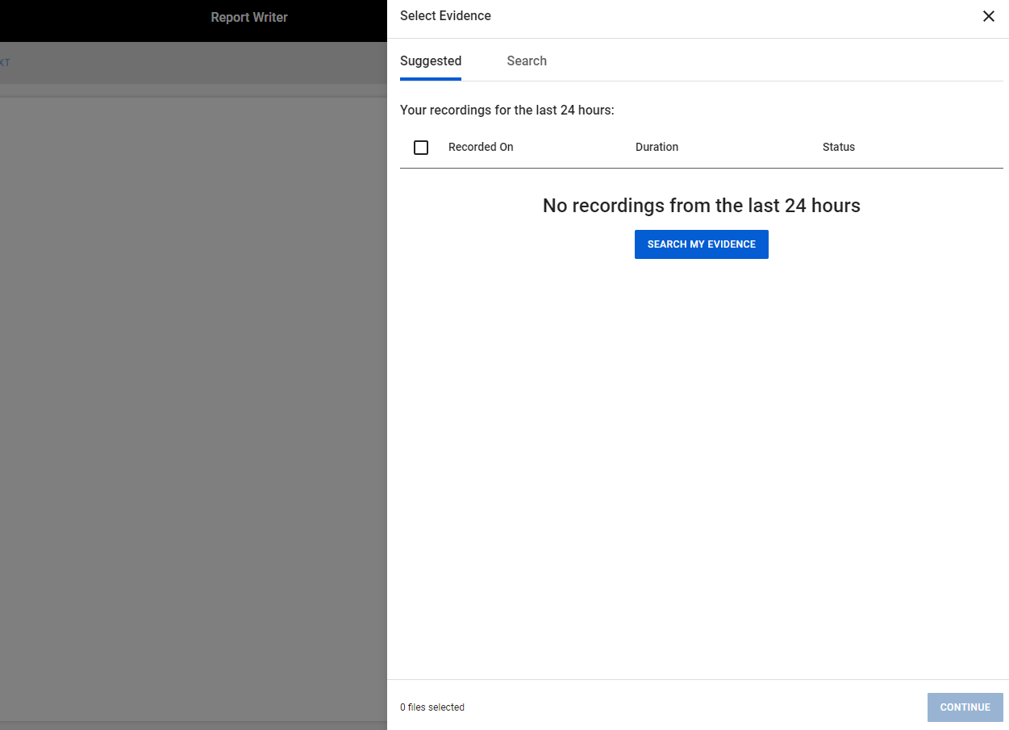
EVENTS THAT HAVE BEEN UPLOADED IN THE LAST 24 HOURS WILL BE AUTOMATICALLY LISTED IN THE SUGGESTED FIELD.

Slide 8
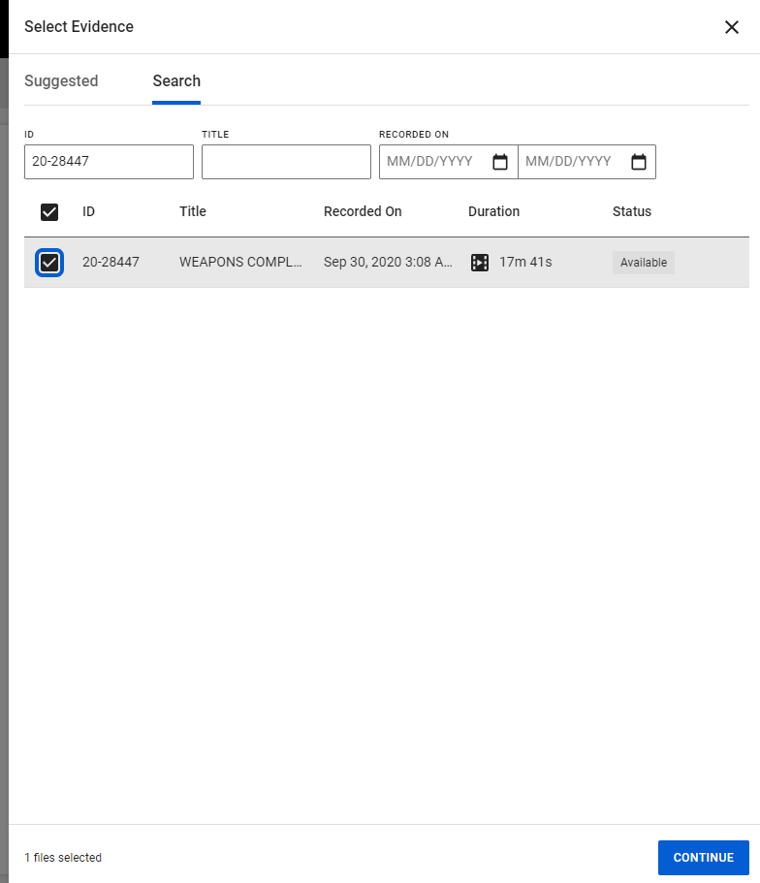
FROM THE SEARCH FIELD YOU CAN ENTER ID NUMBER AND CASE WILL POPULATE; SELECT CASE AND PRESS CONTINUE

Slide 9
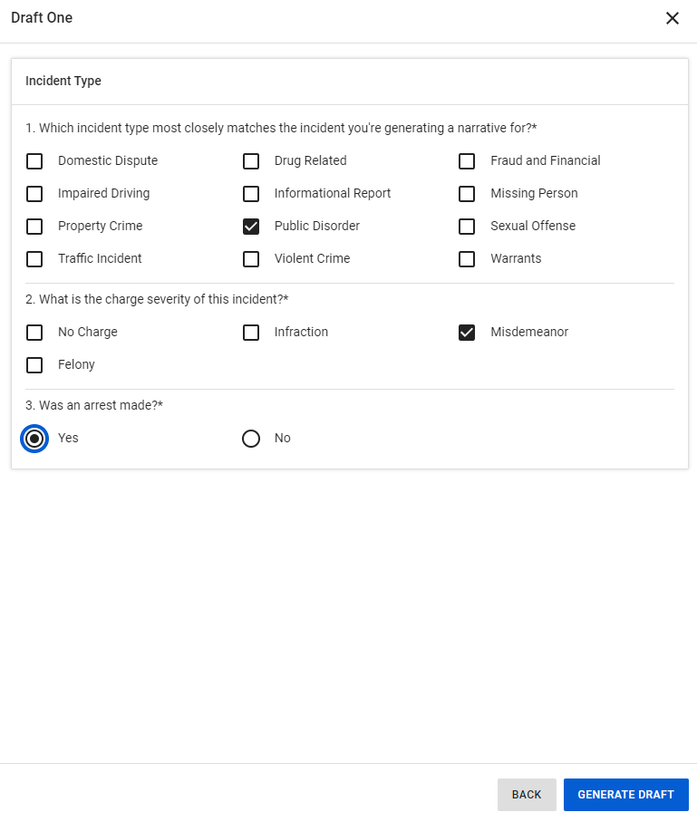
SELECT INCIDENT TYPE…
DOMESTICS, DUI’S, AND FELONIES ARE DISABLED DURING THE TRIAL RUN

Slide 10
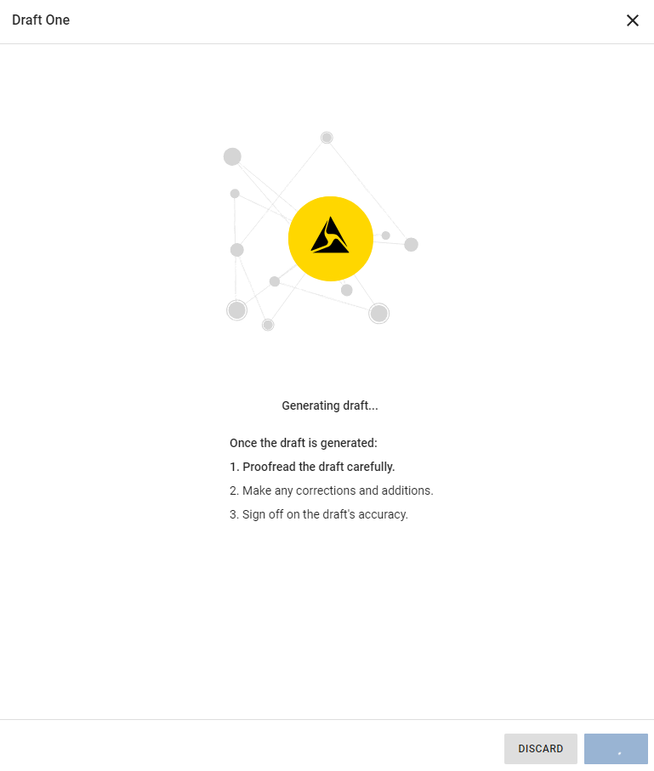
AFTER YOU CLICK
“GENERATE DRAFT”
Draft One will start to produce a narrative

Slide 11
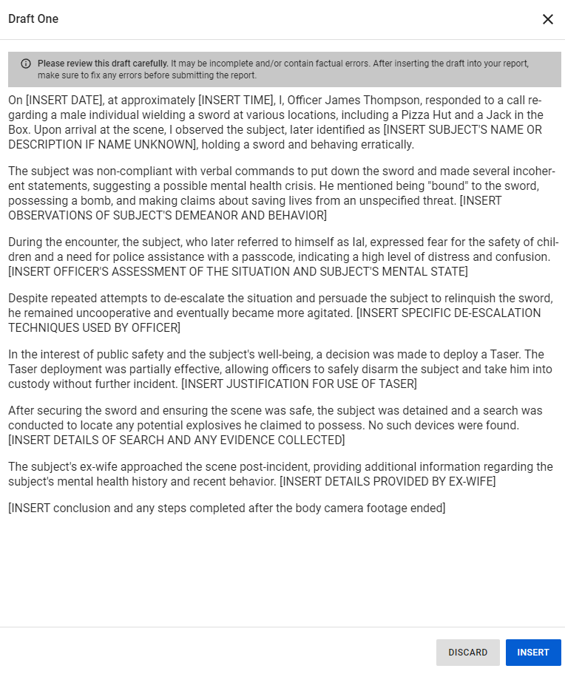
You will receive this draft…
Press “INSERT” to have it go to the editing field.

Slide 12
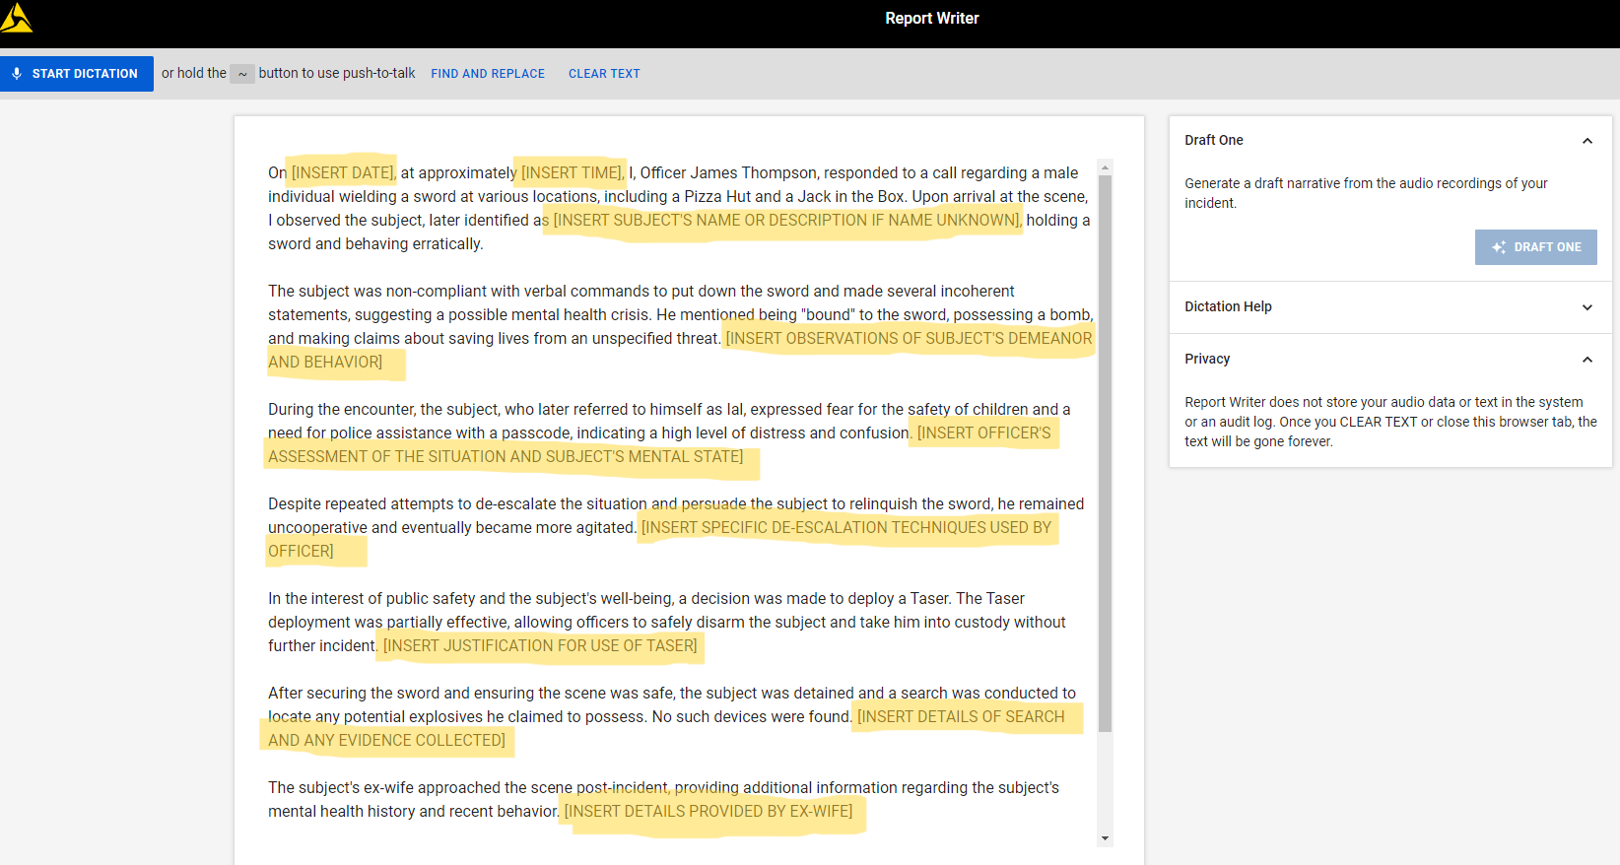
EDITING FIELD

Slide 13
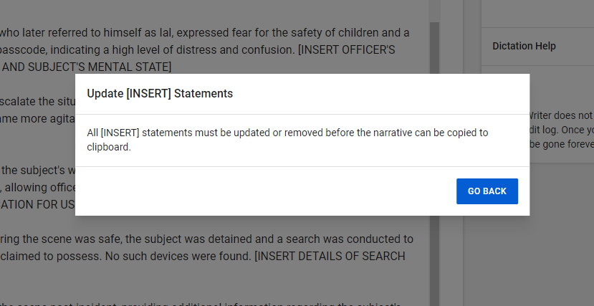
EDITING FIELD

Slide 14
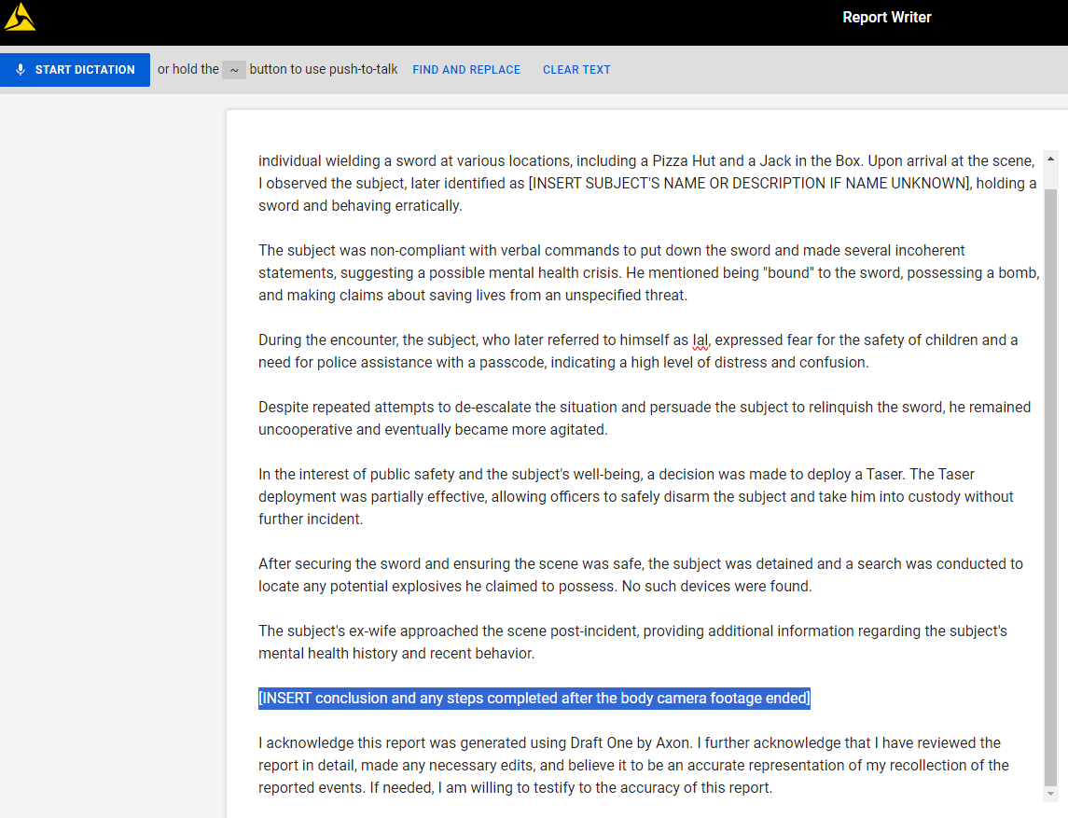
EDITING FIELD – Insert Statements

Slide 15
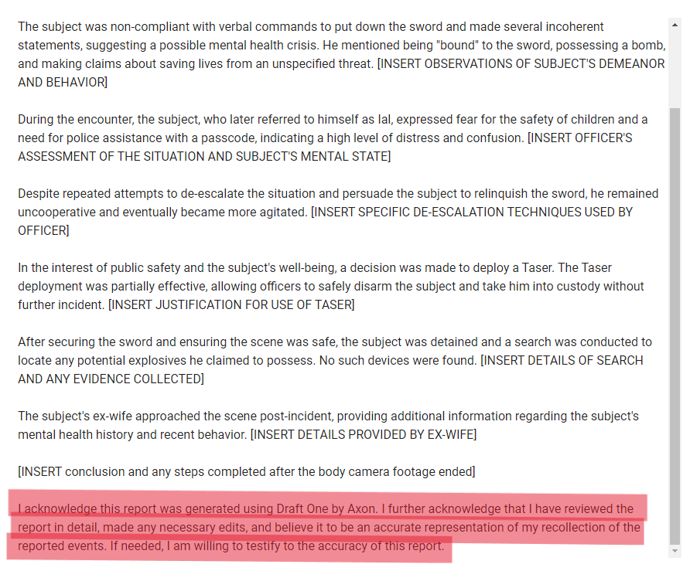
YOUR PERJURY STATEMENT

Slide 16
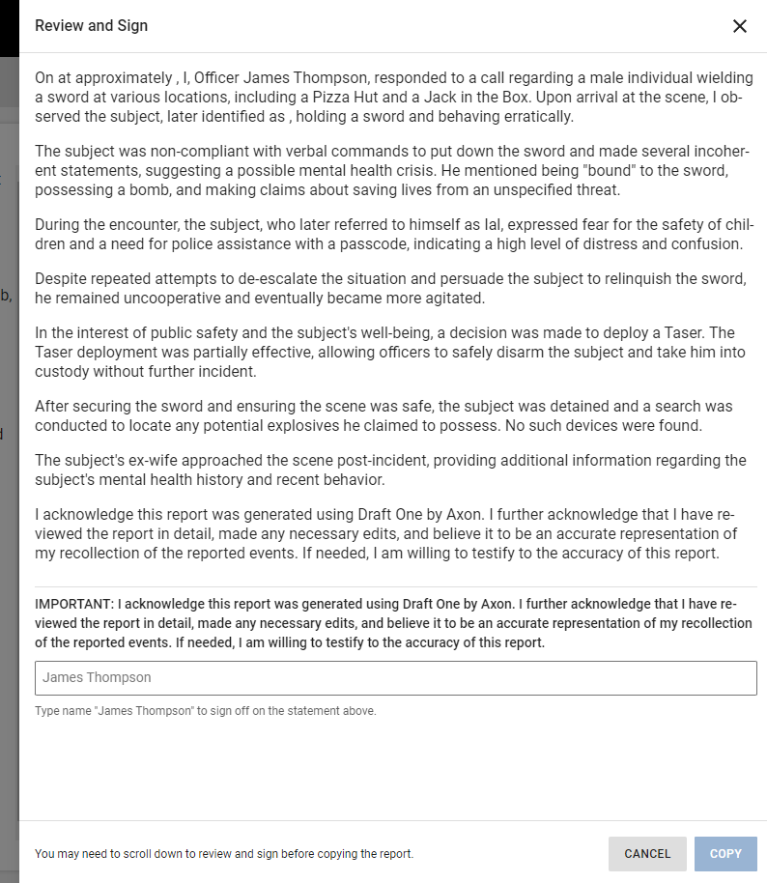
REVIEW AND SIGN
Type Name must MATCH that in the box

Slide 17
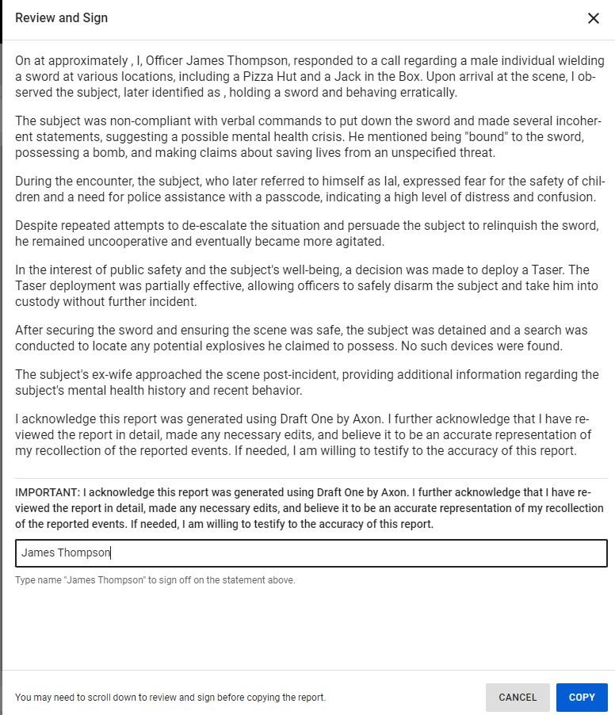
CLICK “COPY” AND NARRATIVE WILL BE COPIED TO YOUR CLIP BOARD

Slide 18
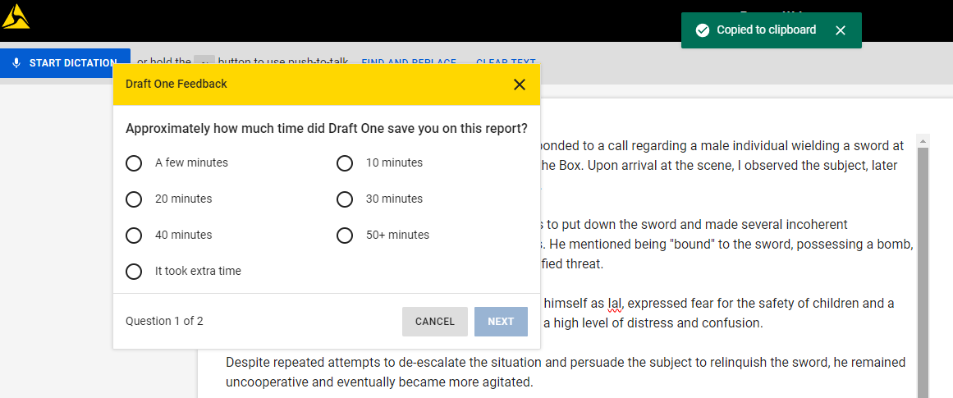
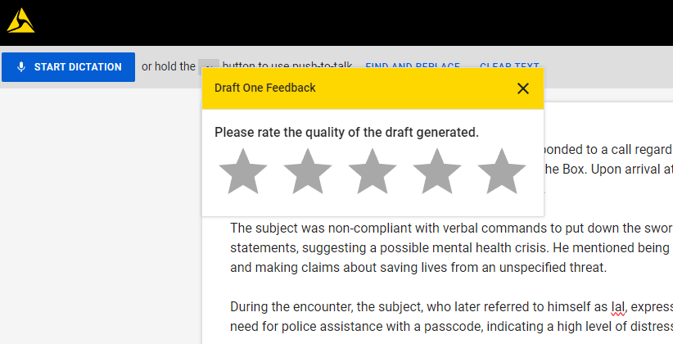
AFTER COPYING TO CLIPBOARD
PASTE TO WORD DOC OR TYLER
TIP: DON’T CLOSE OUT OF DRAFT ONE UNTIL PASTED TO WORD OR TYLER
REMEMBER: IT WILL NOT SAVE IN DRAFT ONE

Slide 19


Questions?

