Slide 1
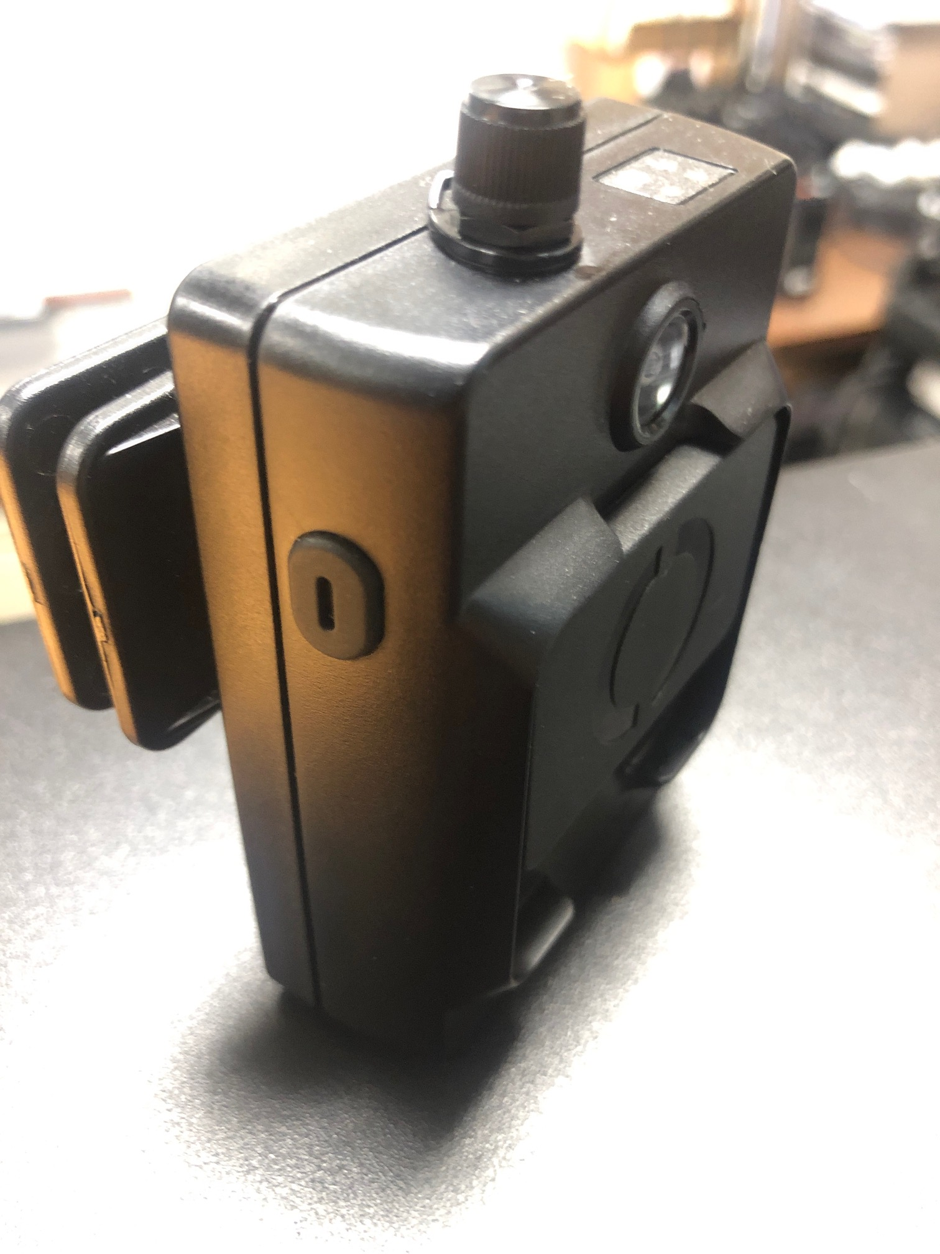
Axon/Vievu LE5 Body Worn Camera
Best Practices Guide

Slide 2
Purpose
The purpose for this training is to familiarize users of the LE5 Body Worn Camera (BWC) with best practices regarding usage of the device.
It’s also an opportunity to share some of the more common issues, concerns, and questions being reported to the Police Information Technology Unit as a result of everyday usage of the device.

Slide 3
Recent Developments
Some users of the are reporting that the BWC will activate a recording, with sound, on its own and without having to move the switch down and into the activate recording position. Reports of an unintentional activation have been received while the BWC is in various conditions:
Docked in a multi-dock workstation
Connected to a desktop computer or MDT using the supplied upload cable
Wearing the device and adjusting equipment
When the BWC’s battery runs low.
Some unintentional activations can be explained through common practice and are addressed in subsequent slides in this presentation. Those that can’t be explained are taken seriously and reported to the manufacturer for further research. If you feel you’ve experienced an unintentional activation as a result of equipment failure it’s important that you report it to the Police Information Technology Unit as soon as possible by calling 510-238-7192 or sending an email to OPDITU@oaklandnet.com. Your BWC will be replaced and the recording will be deleted from the server with supervisor approval.

Slide 4
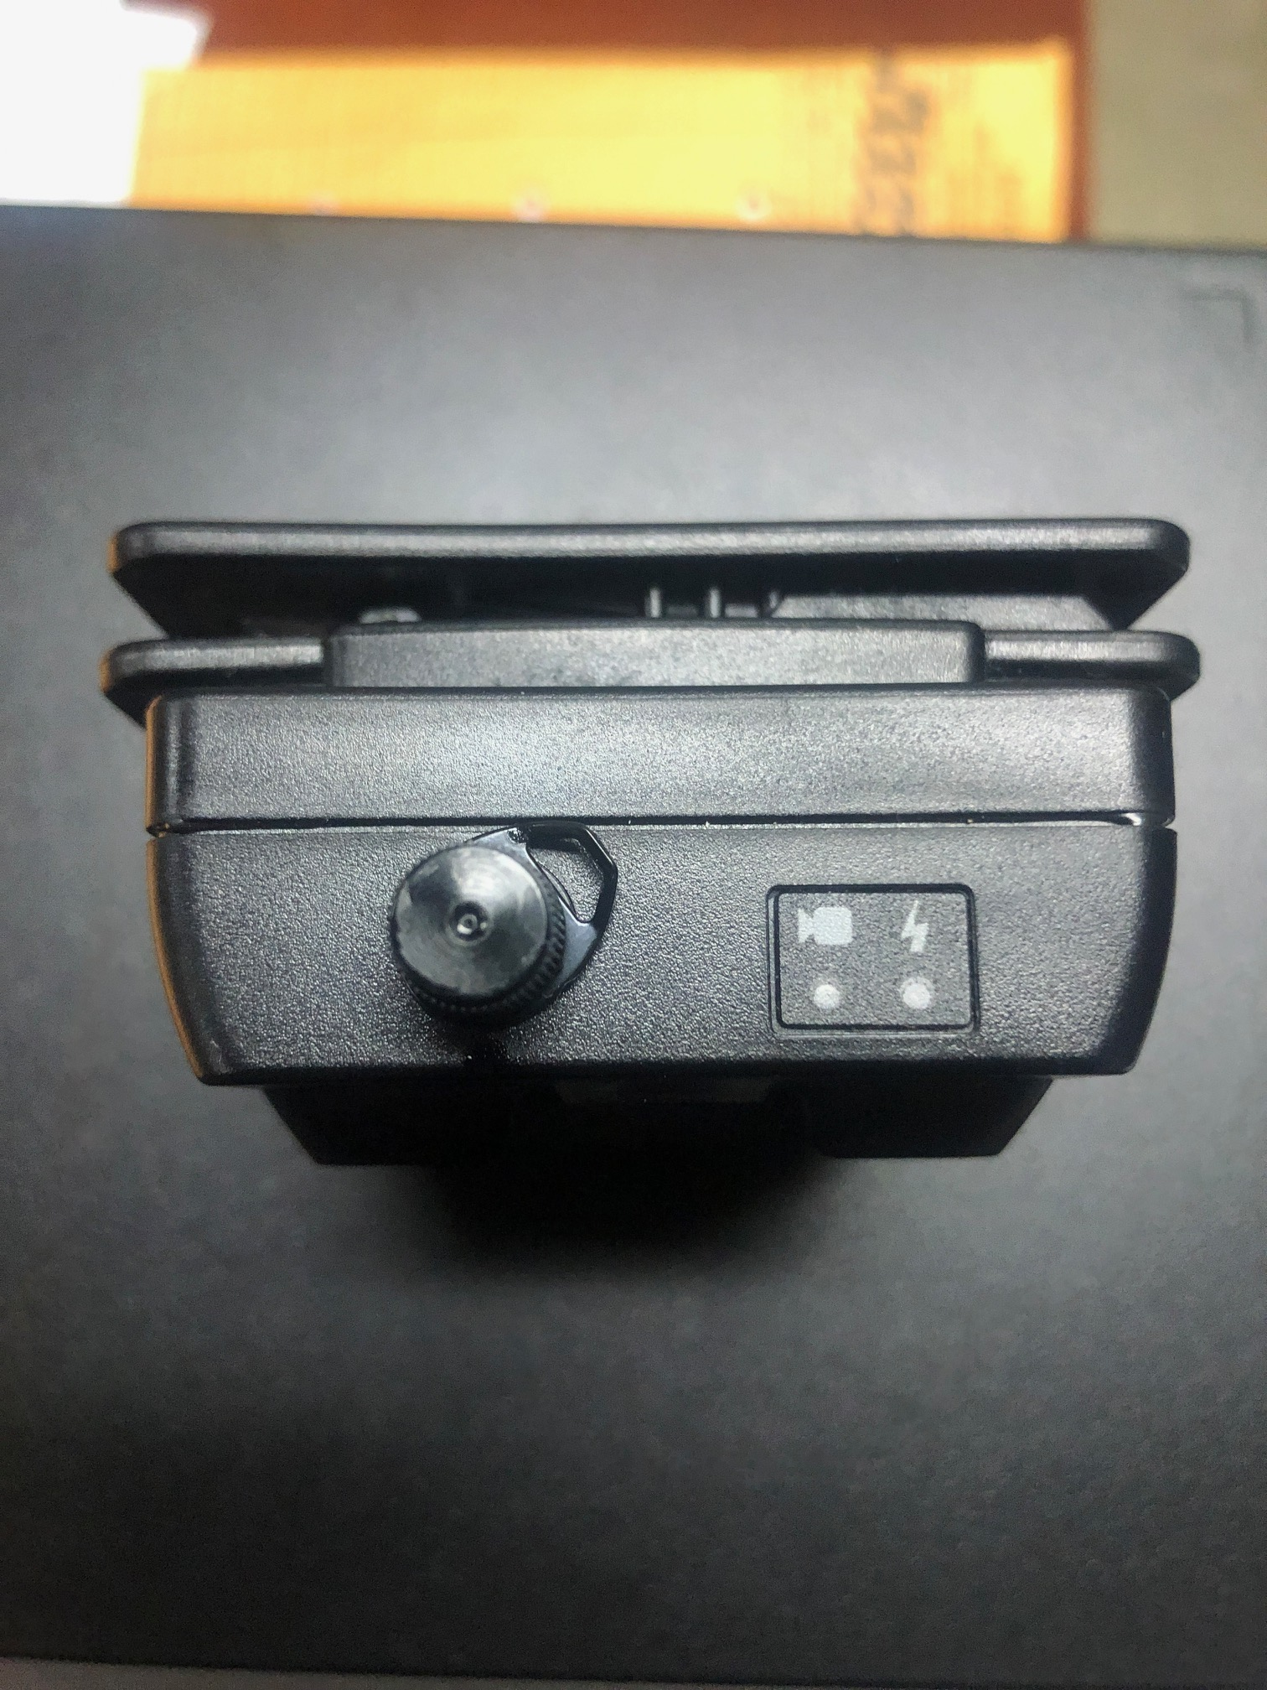
Low Battery Indicator Light
With the implementation of the 30 second pre-record feature, many BWC’s are running into low battery power during a shift. When this happens instead of seeing a slow blinking red standby light, the BWC will display a slow blinking yellow/green light.
Do not confuse a slow blinking yellow/green light with a slow blinking green light that indicates the BWC is recording.
If your BWC is running low battery and you are in the field, use the supplied upload cable to charge it using the vehicles MDT. If you are inside a building, dock your BWC in a multi-dock station to charge it or use the upload cable to charge it while connected to a desktop computer.
When the BWC is in low-battery mode it is not recording until the switch is manually pushed down to activate a recording.
If you feel you have a defective battery turn the BWC in to the Police Information Technology Unit for a replacement.

Slide 5
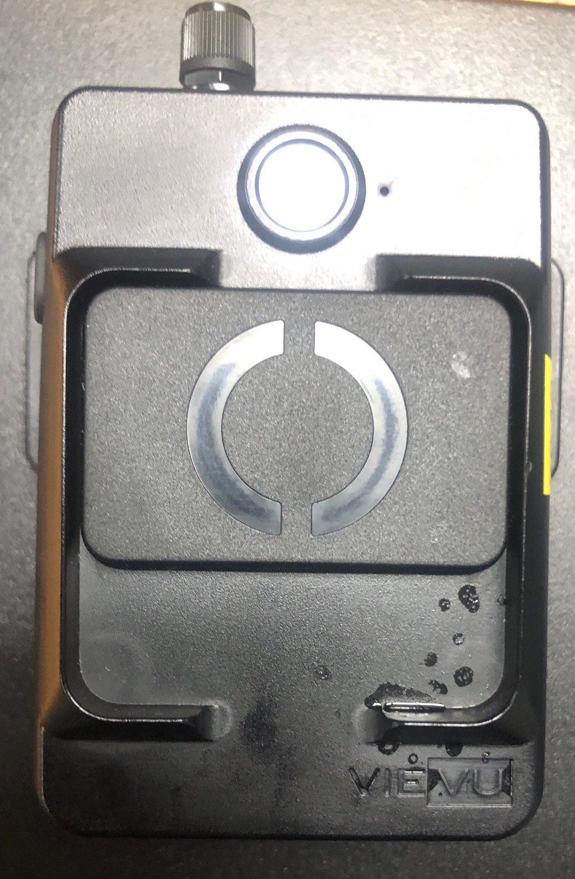
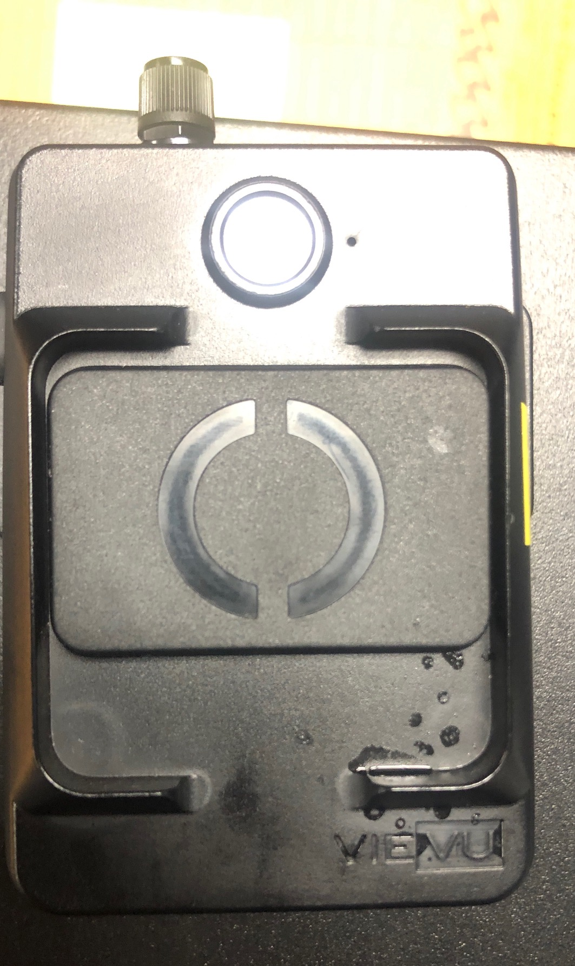
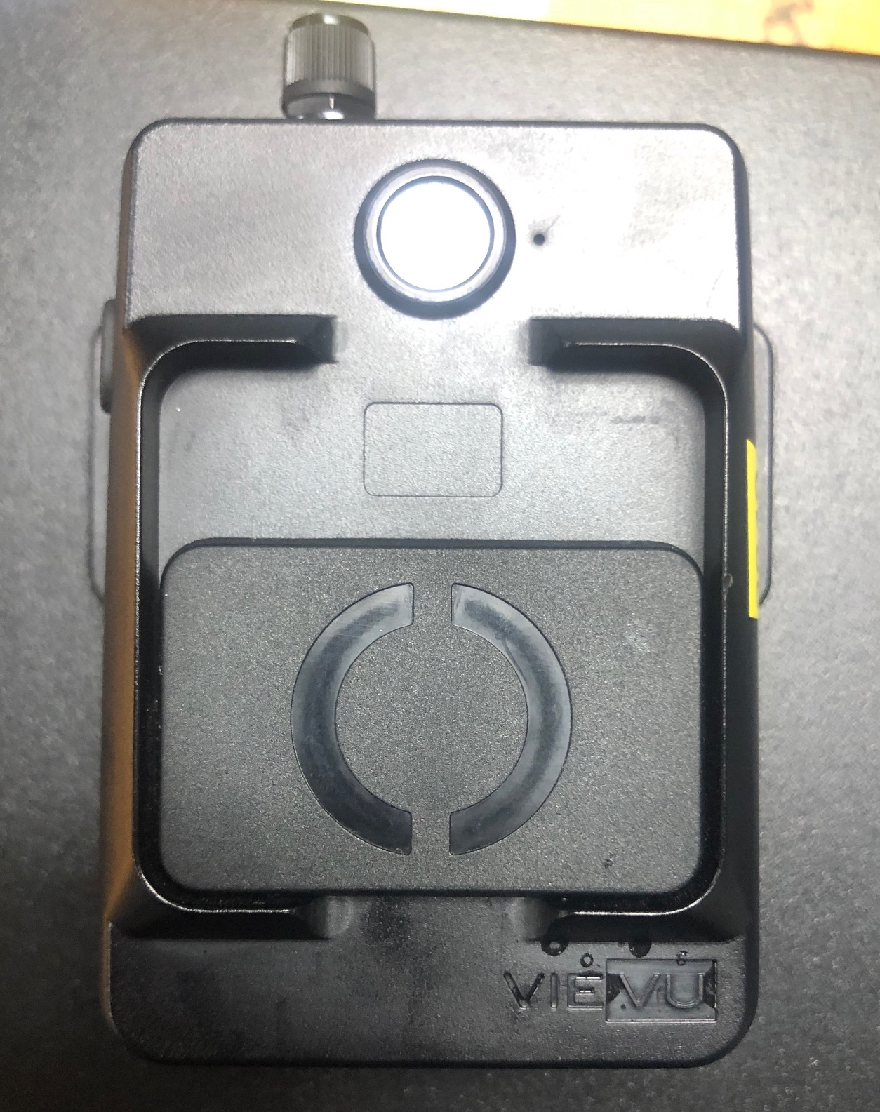
Activating a recording
Fully Closed
Partial Activation
The BWC is equipped with a switch to activate a recording when pushed down. The proper way to activate the BWC is to push the switch down all the way to start a recording.
On occasion the BWC switch will be pushed down slightly and a recording will start. This can happen due to an unintentional activation of the switch (e.g. brushing against an unknown object) or by having a defective switch.
If you feel you have a defective switch turn the BWC in to the Police Information Technology Unit for a replacement.
Full Activation

Slide 6
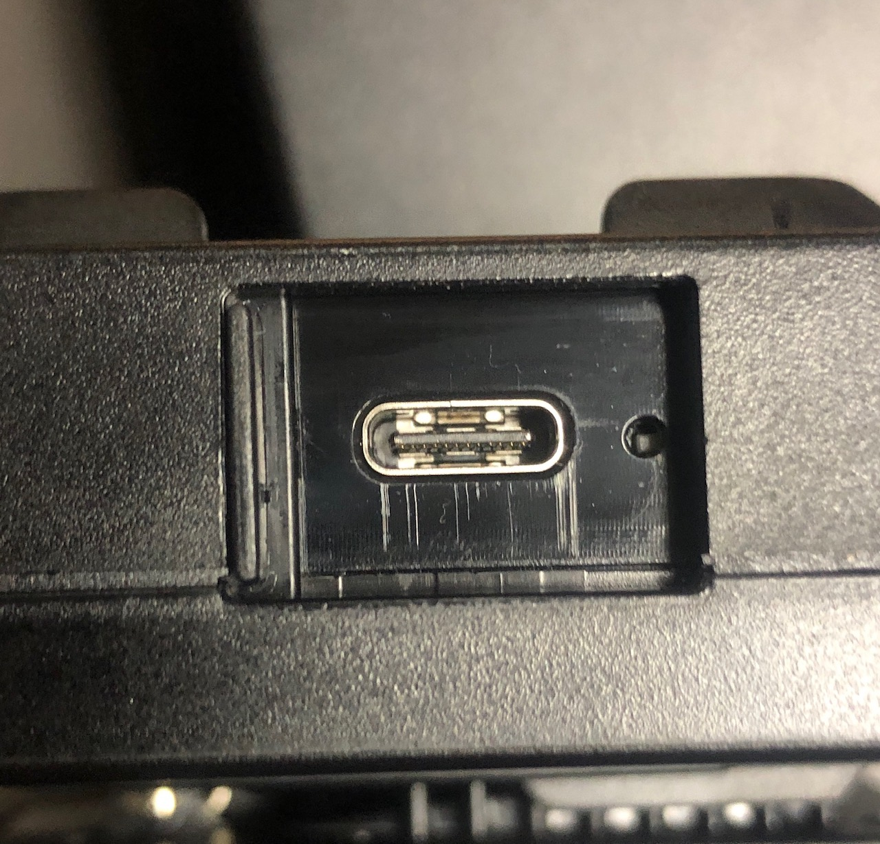
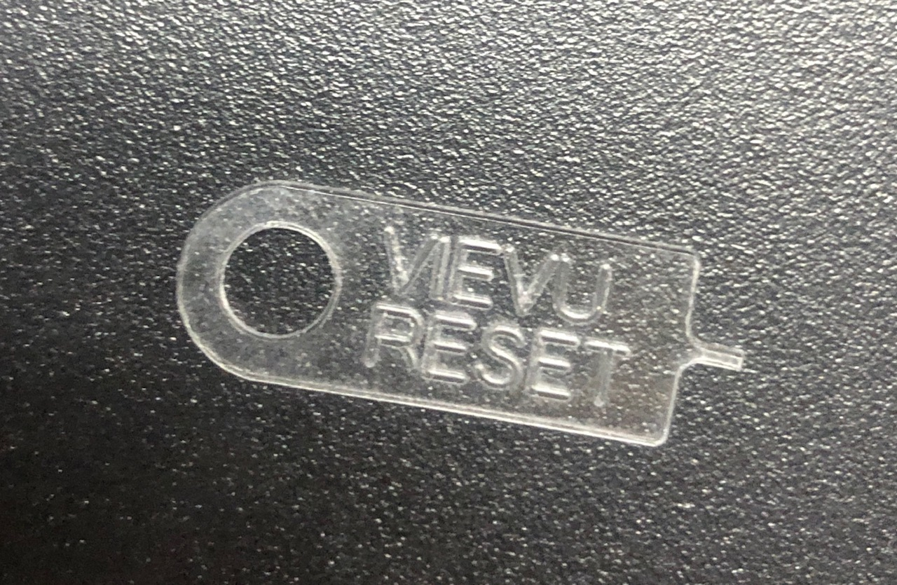
Reset Button
Reset Button
Just like a computer, there are times when your BWC is acting strange and needs to be reset.
Some common symptoms of the BWC needing a reset are:
1. Not charging properly.
2. Will not turn on.
3. Status lights on top show solid red.
If this happens, use the supplied VieVu Reset Tool to reset the BWC. Simply press the button located on the bottom of the BWC. DO Not use a pen, handcuff key, or other miscellaneous object to reset the BWC. Doing so can puncture the internal lithium-ion battery.
If this does not fix the issue, turn the BWC in to the Police Information Technology Unit for a replacement.
Reset Tool

Slide 7
Test Activation
At the beginning of a shift all BWC users are required by policy to perform a “test” activation to ensure the BWC is operating properly.
To perform a proper test activation, place the BWC in record mode by pushing down on the switch and allowing the BWC to display a slow blinking green light 5 times, or approximately 10 seconds. When you are done, push up on the switch to deactivate the recording mode.
Failure to allow the BWC to fully activate the recording mode can cause the BWC to continue to record while the switch is in the up position. This is most commonly caused by activating and deactivating the record mode (sliding the shutter down and then back up) too quickly.

Slide 8
Unintentional recordings (recap)
As previously mentioned each one of these events is taken seriously and we are working with the manufacturer (Axon) for a possible cause and solution. If you discover an unintentional recorded video, report it immediately to the Police Information Technology Unit by calling 510-238-7192 or by sending an email to opditu@oaklandnet.com. The BWC will be replaced upon receipt of the defective equipment.
If the video needs to be deleted, per BWC policy a supervisor needs to send an email to the Police Information Technology Unit requesting that the video be removed from the server.

Slide 9
Questions?
If you have any questions about the BWC program, including the hardware or software, don’t hesitate to ask.
The Police information Technology Unit is staffed Monday to Friday, 0600-2200 hours. You can call, send an email, or just stop by the PAB, 9th Floor Rm 900. We’re here to help.
Thank You
Police Information Technology Unit
510-238-7192
opditu@oaklandnet.com

