Slide 1


RIVERSIDE COUNTY SHERIFF’S DEPARTMENT

Slide 2
Presentation Overview
What is ALPR
Users, Sharing, Purging, Audits
Laws and Policies
Use Cases
Patrol Response
Report Writing
Damage Process
CPRA Requests
RIVERSIDE COUNTY SHERIFF’S DEPARTMENT

Slide 3
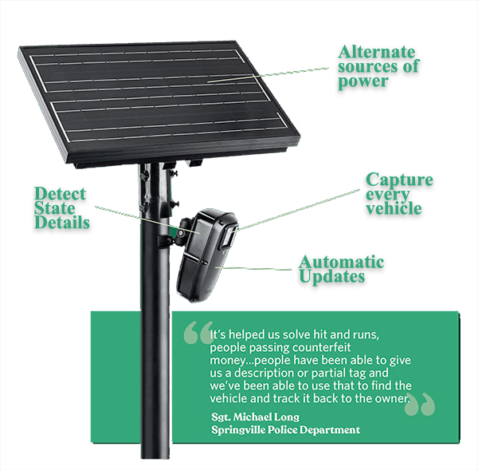
What is ALPR
Captures Still Images
Date, Time & Location
Converts License Plates to Alphanumeric Characters
Vehicle Fingerprint
Does Not Link to DMV
Does Not Use Facial Recognition
Does Not Record Video/Audio
Does Not PTZ (Pan, Tilt, Zoom)
Does Not Enforce Traffic Violations
Downloads DOJ Hot Lists (Plates & Wants Only)
Users Can Create Own Hot Lists
RIVERSIDE COUNTY SHERIFF’S DEPARTMENT

Slide 4
ALPR Users
ALPR Operator
RCSD a Public Agency
End Users
Deputies, Investigators, Crime Analysts
RIVERSIDE COUNTY SHERIFF’S DEPARTMENT

Slide 5
ALPR Sharing, Purging, Audits
Sharing
Through Agreements with California LE Agencies
1 to 1 Sharing
No Sharing (“Access”) with Non-California Agencies (No SB34 Compliance)
Purging
30 Day Retention – Automatic Purge
Audit
Routine audits of inquires
Searches must be justified!
RIVERSIDE COUNTY SHERIFF’S DEPARTMENT

Slide 6
ALPR – California SB34 (2015)
Requires…
ALPR users safeguard data
Agencies to create and maintain a policy
Post on agency website
Agency host public meeting prior to program implementation
Allows civil recourse to those harmed by negligent release
Requires agencies to provide training to users
Required Software Provider to be CJIS Compliant
Audit trail for use of database
RIVERSIDE COUNTY SHERIFF’S DEPARTMENT

Slide 7
ALPR – California SB54
California Senate Bill 54 effectively makes California a “sanctuary state” by legalizing and standardizing statewide non-cooperation policies between California law enforcement agencies and federal immigration authorities…”
Department Policies also PROHIBIT Immigration Enforcement Action and Inquiries
RIVERSIDE COUNTY SHERIFF’S DEPARTMENT

Slide 8
Department Policies Immigration Violations
445.4 IMMIGRATION ENFORCEMENT INQUIRIES PROHIBITED
Deputies shall not inquire into an individual’s immigration status for immigration enforcement purposes and shall not assist with or perform the functions of an immigration officer whether formally or informally (Government Code § 7284.6). This does not prevent employees from asking arrestees / inmates about place of birth or citizenship to comply with consular notification requirements (834c PC), or to inquire about legal status to comply with or enforce other state laws (e.g., 26505 PC).

Slide 9
Department Policies Immigration Violations
445.4.1 CALIFORNIA LAW ENFORCEMENT TELECOMMUNICATIONS SYSTEM (CLETS)
Members shall not use information transmitted through CLETS for immigration enforcement purposes except for criminal history information and only when consistent with the California Values Act (Government Code § 15160).
Members shall not use the system to investigate immigration violations of 8 USC § 1325 (improper entry) if that violation is the only criminal history in an individual’s record (Government Code § 15160).

Slide 10
Department Policies Department Standards
346.4.4 OFF-DUTY USE
Members shall only use technology resources provided by the department while on-duty or in conjunction with specific on-call assignments unless authorized by a supervisor to do otherwise. This includes the use of telephones, cell phones, texting, email or any other "off the clock" work-related activities. This also applies to personally owned devices that are used to access department resources.

Slide 11
Department Policies Department Standards
346.8 PASSWORDS MANAGEMENT
Passwords must be strong and well guarded. New accounts will be set up in accordance with this policy and any applicable department requirements. Users are responsible for choosing passwords that are highly secure. Users shall never divulge their passwords to others.

Slide 12
Department Policies Department Standards
346.5 PROTECTION OF AGENCY SYSTEMS AND FILES
Members shall ensure department computers and access terminals are not viewable by persons who are not authorized users. Computers and terminals should be secured, users logged off and password protections enabled whenever the user is not present. Access passwords, logon information, and other individual security data, protocols, and procedures are confidential information and are not to be shared.
It is prohibited for a member to allow an unauthorized user to access the computer system at any time or for any reason. Members shall promptly report any unauthorized access to the computer system or suspected intrusion from outside sources (including the internet) to a supervisor.

Slide 13
ALPR Use Case
Quickly Locate Wanted Vehicles
Stolen Vehicles
Felony Vehicles
Silver Alert
Amber Alerts
Common Plate Analysis
Ability to Generate Leads
Solve Crimes Faster
Arrest Suspects Faster
RIVERSIDE COUNTY SHERIFF’S DEPARTMENT

Slide 14
Not Uses Cases
Not Used to for Traffic Enforcement
Not Used for Immigration Enforcement
Data Not Shared with Federal Agencies (SB54)
Department Policy Prohibits Data Sharing with Federal Agencies
Not Used for Live Surveillance
Collects Still Images Only
Date/Time & Location
Make, Color and Unique Features of Vehicle
Alphanumeric License Plate
RIVERSIDE COUNTY SHERIFF’S DEPARTMENT

Slide 15
Patrol Response
Flock Deployment
Intended to Reduce Crime
Investigative Leads
Focus on wanted vehicles
Patrol Responses to Flock Alerts ARE encouraged
Patrol Calls should not be secondary to Flock Alerts
Evaluation of Calls vs. Flock Hits (Deputy on a 459P vs. Nearby Alert of 215 Vehicle)
RIVERSIDE COUNTY SHERIFF’S DEPARTMENT

Slide 16
Patrol Response
Alert Confirmation
All ALPR Alerts SHALL be Verified before Enforcement Action is Taken
Dispatch Inquiry
MDC CLETS Inquiry
RIVERSIDE COUNTY SHERIFF’S DEPARTMENT

Slide 17
Report Writing
412.4.1 REPORT WRITING
The ALPR EDP code shall be used as a secondary EDP and is required on any written report where ALPR technology was effectively utilized during an investigation.
For example, if an abandoned stolen vehicle is located via a notification from the ALPR system, the recovery should be documented as a Stolen Vehicle Recovery and the corresponding EDP for the recovery should be first on the Form A. On the second line of the Form A, “ALPR” should be entered in the offense section and "25T1-N" should be entered in the EDP code section. This practice will ensure proper identification of ALPR-related incidents and crime trends.
RIVERSIDE COUNTY SHERIFF’S DEPARTMENT

Slide 18
Damaged Cameras
Flock is a Software-as-a-Service (SaaS)
Flock retains ownership of all hardware
No ACCORD is Needed
Damaged Hardware Documentation (Additional Fees Apply)
Traffic Collision or other Criminal Report
RIVERSIDE COUNTY SHERIFF’S DEPARTMENT

Slide 19
CPRA Requests
CPRA Requests handled by CPRA Unit
On August 31, 2017, the California Supreme Court, in ACLU of Southern Calif. v. Super Court of Los Angeles (County of LA, et. al. Real Parties), __ Cal. 5th ___ (2017), affirmed the Superior Court’s decision to exempt raw Automated License Plate Reader (“ALPR”) data from disclosure under the California Public Records Act (“CPRA”).
RIVERSIDE COUNTY SHERIFF’S DEPARTMENT

Slide 20
Thank You!
RIVERSIDE COUNTY SHERIFF’S DEPARTMENT

