Slide 1

Axon body 2
Spokane Police Training

Slide 2
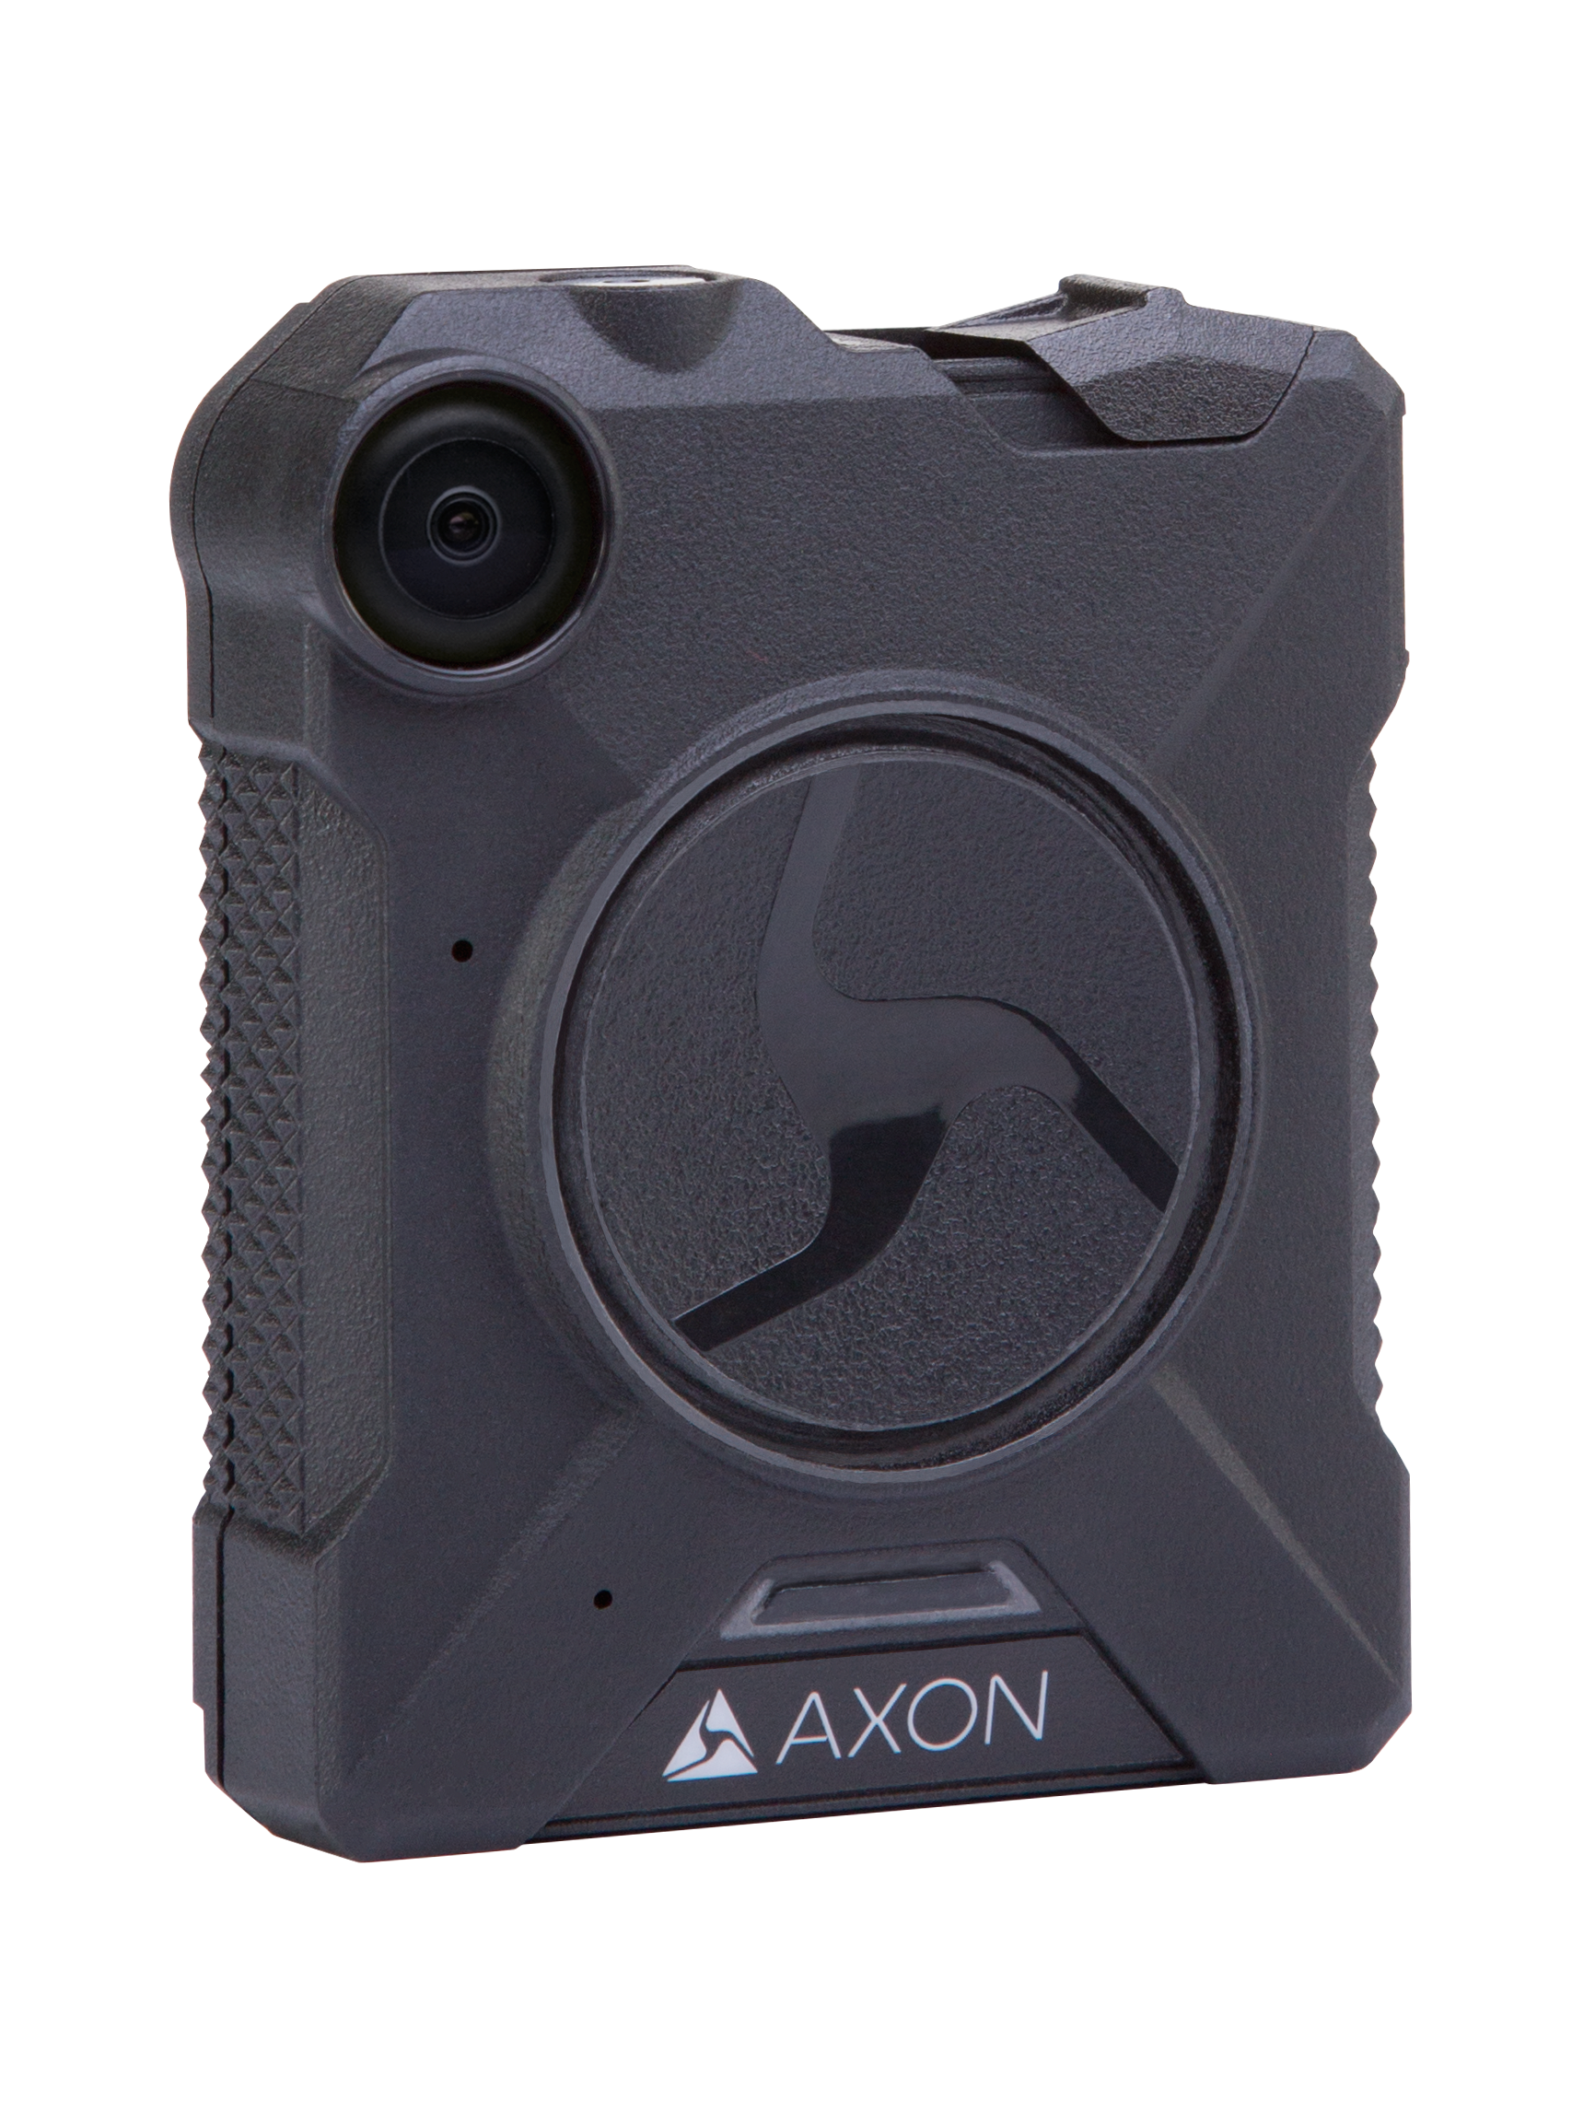
Axon Body 2 overview
Configurable HD Capability
Dual Channel Audio
Markers
Mounts
Vibrating Feedback
2
Notes:
Enhanced features of this BWC System:
Configurable HD Capability
Dual Channel Audio
Mute and Markers
Newly Designed Mount
Vibrating Feedback

Slide 3
Axon Body 2 overview
More than 12 hours of battery life under normal operation
30 frames per second
143° diagonal field of view camera lens
480, 720 HD,1080 HD
3
Notes:
Enhanced features of this BWC System:
Configurable HD Capability
Dual Channel Audio
Mute and Markers
Improved Mount
Vibrating Feedback

Slide 4
Axon Body 2 overview
SPD’s administrator can further configure your Axon Body 2 system with these features:
Pre-event buffer for 1minute
Wi-Fi to pair your Axon Body 2 camera to the Axon View application
Haptic (status notification via device vibration)
Video quality
4

Slide 5
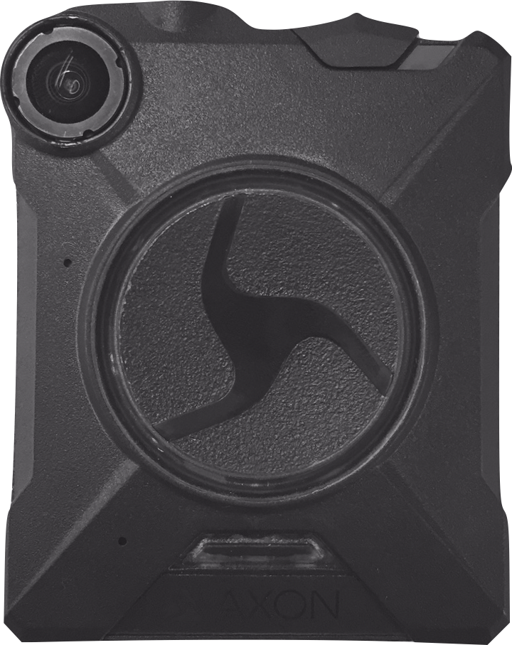
AXON Body 2 operating functions
On/Off Switch
Function Button
Battery LED
Battery Status Button
Lens
Speaker
EVENT Button
Microphone
Notes:
Microphone – For dual channel audio recording.

Slide 6
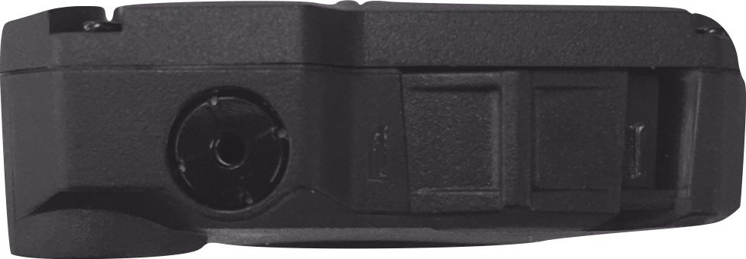
AXON Body 2 operating functions
Operation LED
Connection Socket
Function LED

Slide 7
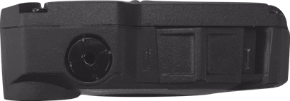
AXON Body 2 operating functions
On/Off Switch
Notes:
On/Off Switch – Turns the camera’s power on or off.
On/Off Indicator – When the camera’s power is turned on, the red portion is exposed. When the camera power is turned off, the red portion is covered from view.

Slide 8
Buffering mode
The BUFFERING mode is configurable up to 2 minutes; however, the default mode is 30 seconds.
SPD cameras buffer 1 minute.
8
Notes:
Buffering mode is configurable up to 2 minutes!!!
Buffering is configurable up to 2 minutes, but the default is 30 seconds

Slide 9
Recording videos
To start recording video,
double tap the EVENT Button.
Notes:
The Event button is located on the front and center of the Controller.

Slide 10
Recording videos
To stop recording,
press and hold the EVENT Button.
Notes:
The Event button is located on the front and center of the Controller.
Some issues with this location to be aware of: lateral vascular neck restraint can shut the camera off.
Long 5 second hold of this button will stop recording.

Slide 11
Operating MODES
Operation LED | Operating Mode
Solid Red | Booting Up
Blinking Green | Buffering
Blinking Red | Recording
11

Slide 12
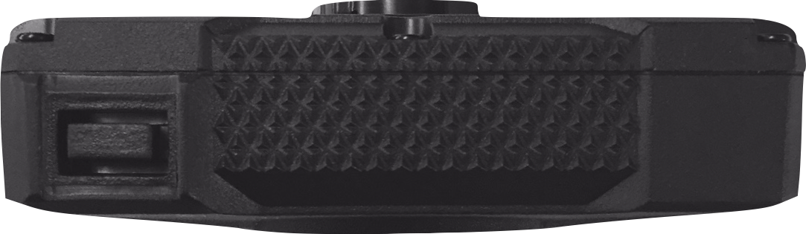
adding markers
Press and release the function button.
Function Button
Notes:
The function button is located on the left side of the device.

Slide 13
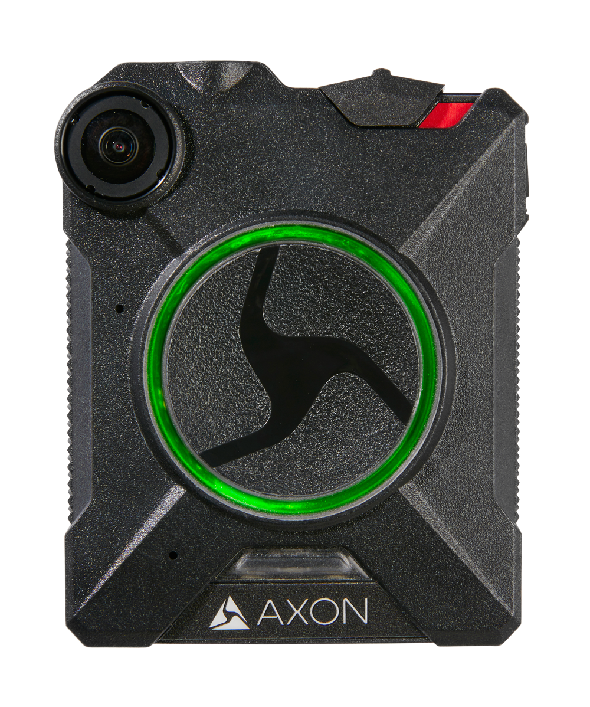
Battery Life
Battery LED | Battery Life Indicator
Solid Green | 41 – 100%
Notes:
Just because it is green does not mean it is fully charged.
Cameras will obviously use more power when recording etc…

Slide 14
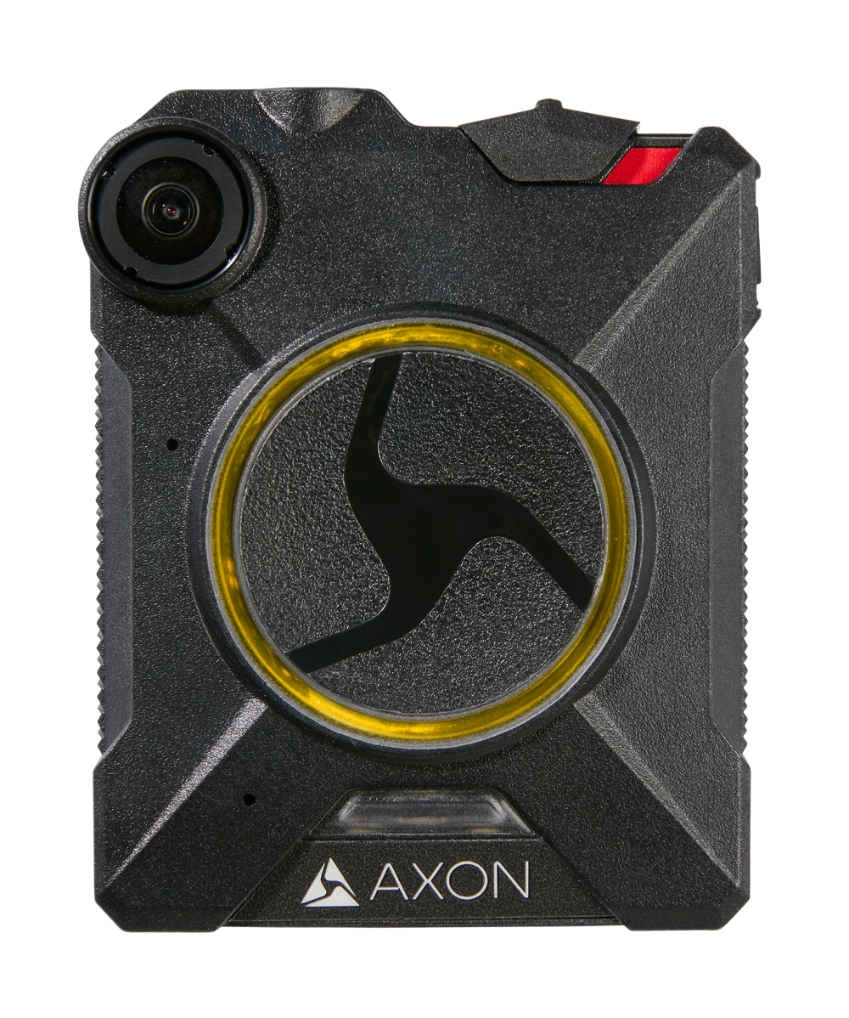
Battery Life
Battery LED | Battery Life Indicator
Solid Green | 41 – 100%
Solid Yellow | 20 – 40%

Slide 15
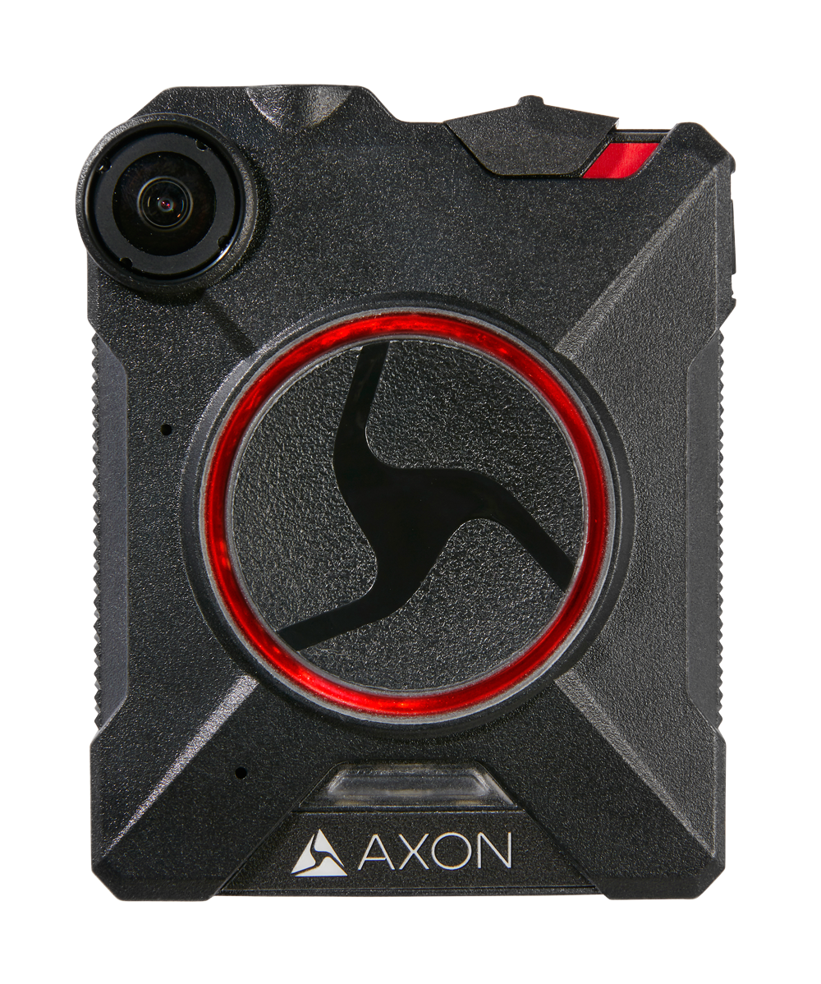
Battery Life
Battery LED | Battery Life Indicator
Solid Green | 41 – 100%
Solid Yellow | 20 – 40%
Solid Red | 0 – 19%
Blinking Red & Yellow | Depleted Dead Battery
Notes:
When the battery reaches this stage, it will continually beep and vibrate until dead. Be aware for those of you that do not use the docks for upload and charging.
K-9, traffic and PACT.

Slide 16
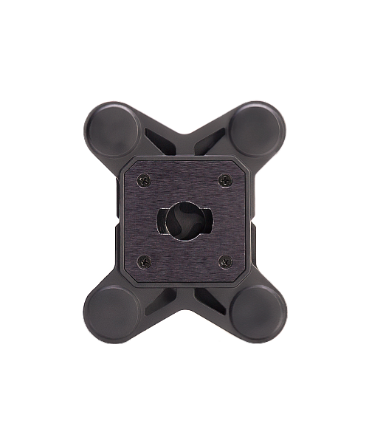
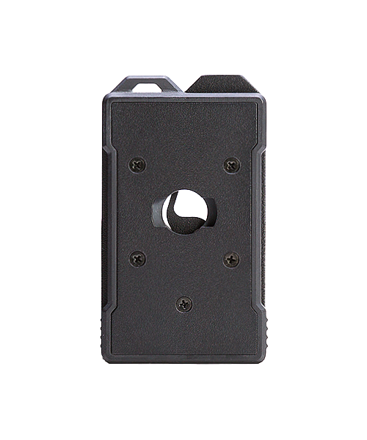
Mounting
Flexible Mount
Outerwear Mount
Notes:
We also have Molle mounts for outer vest carriers only.

Slide 17
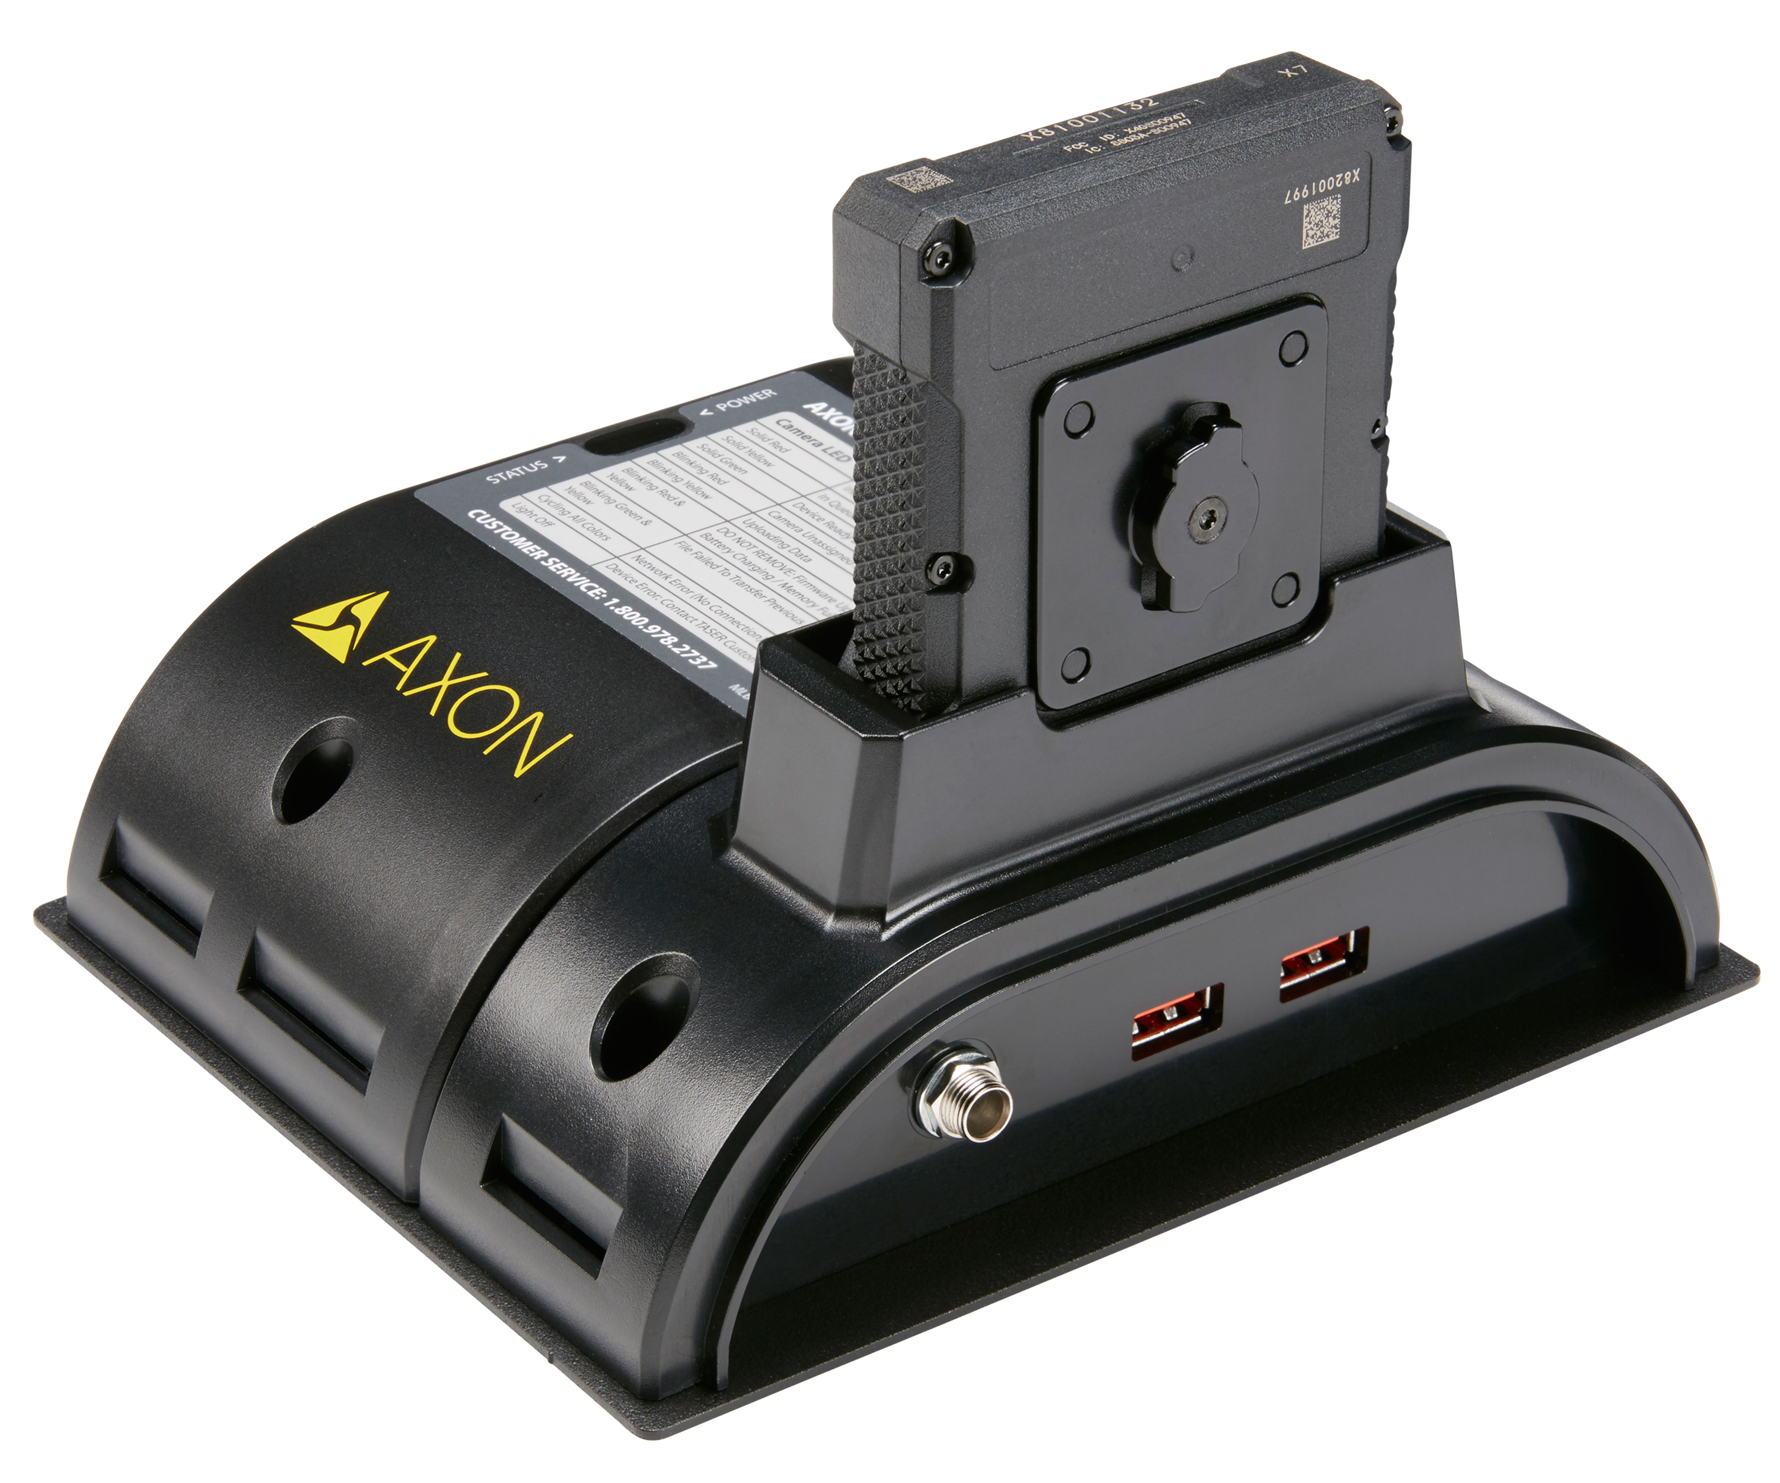
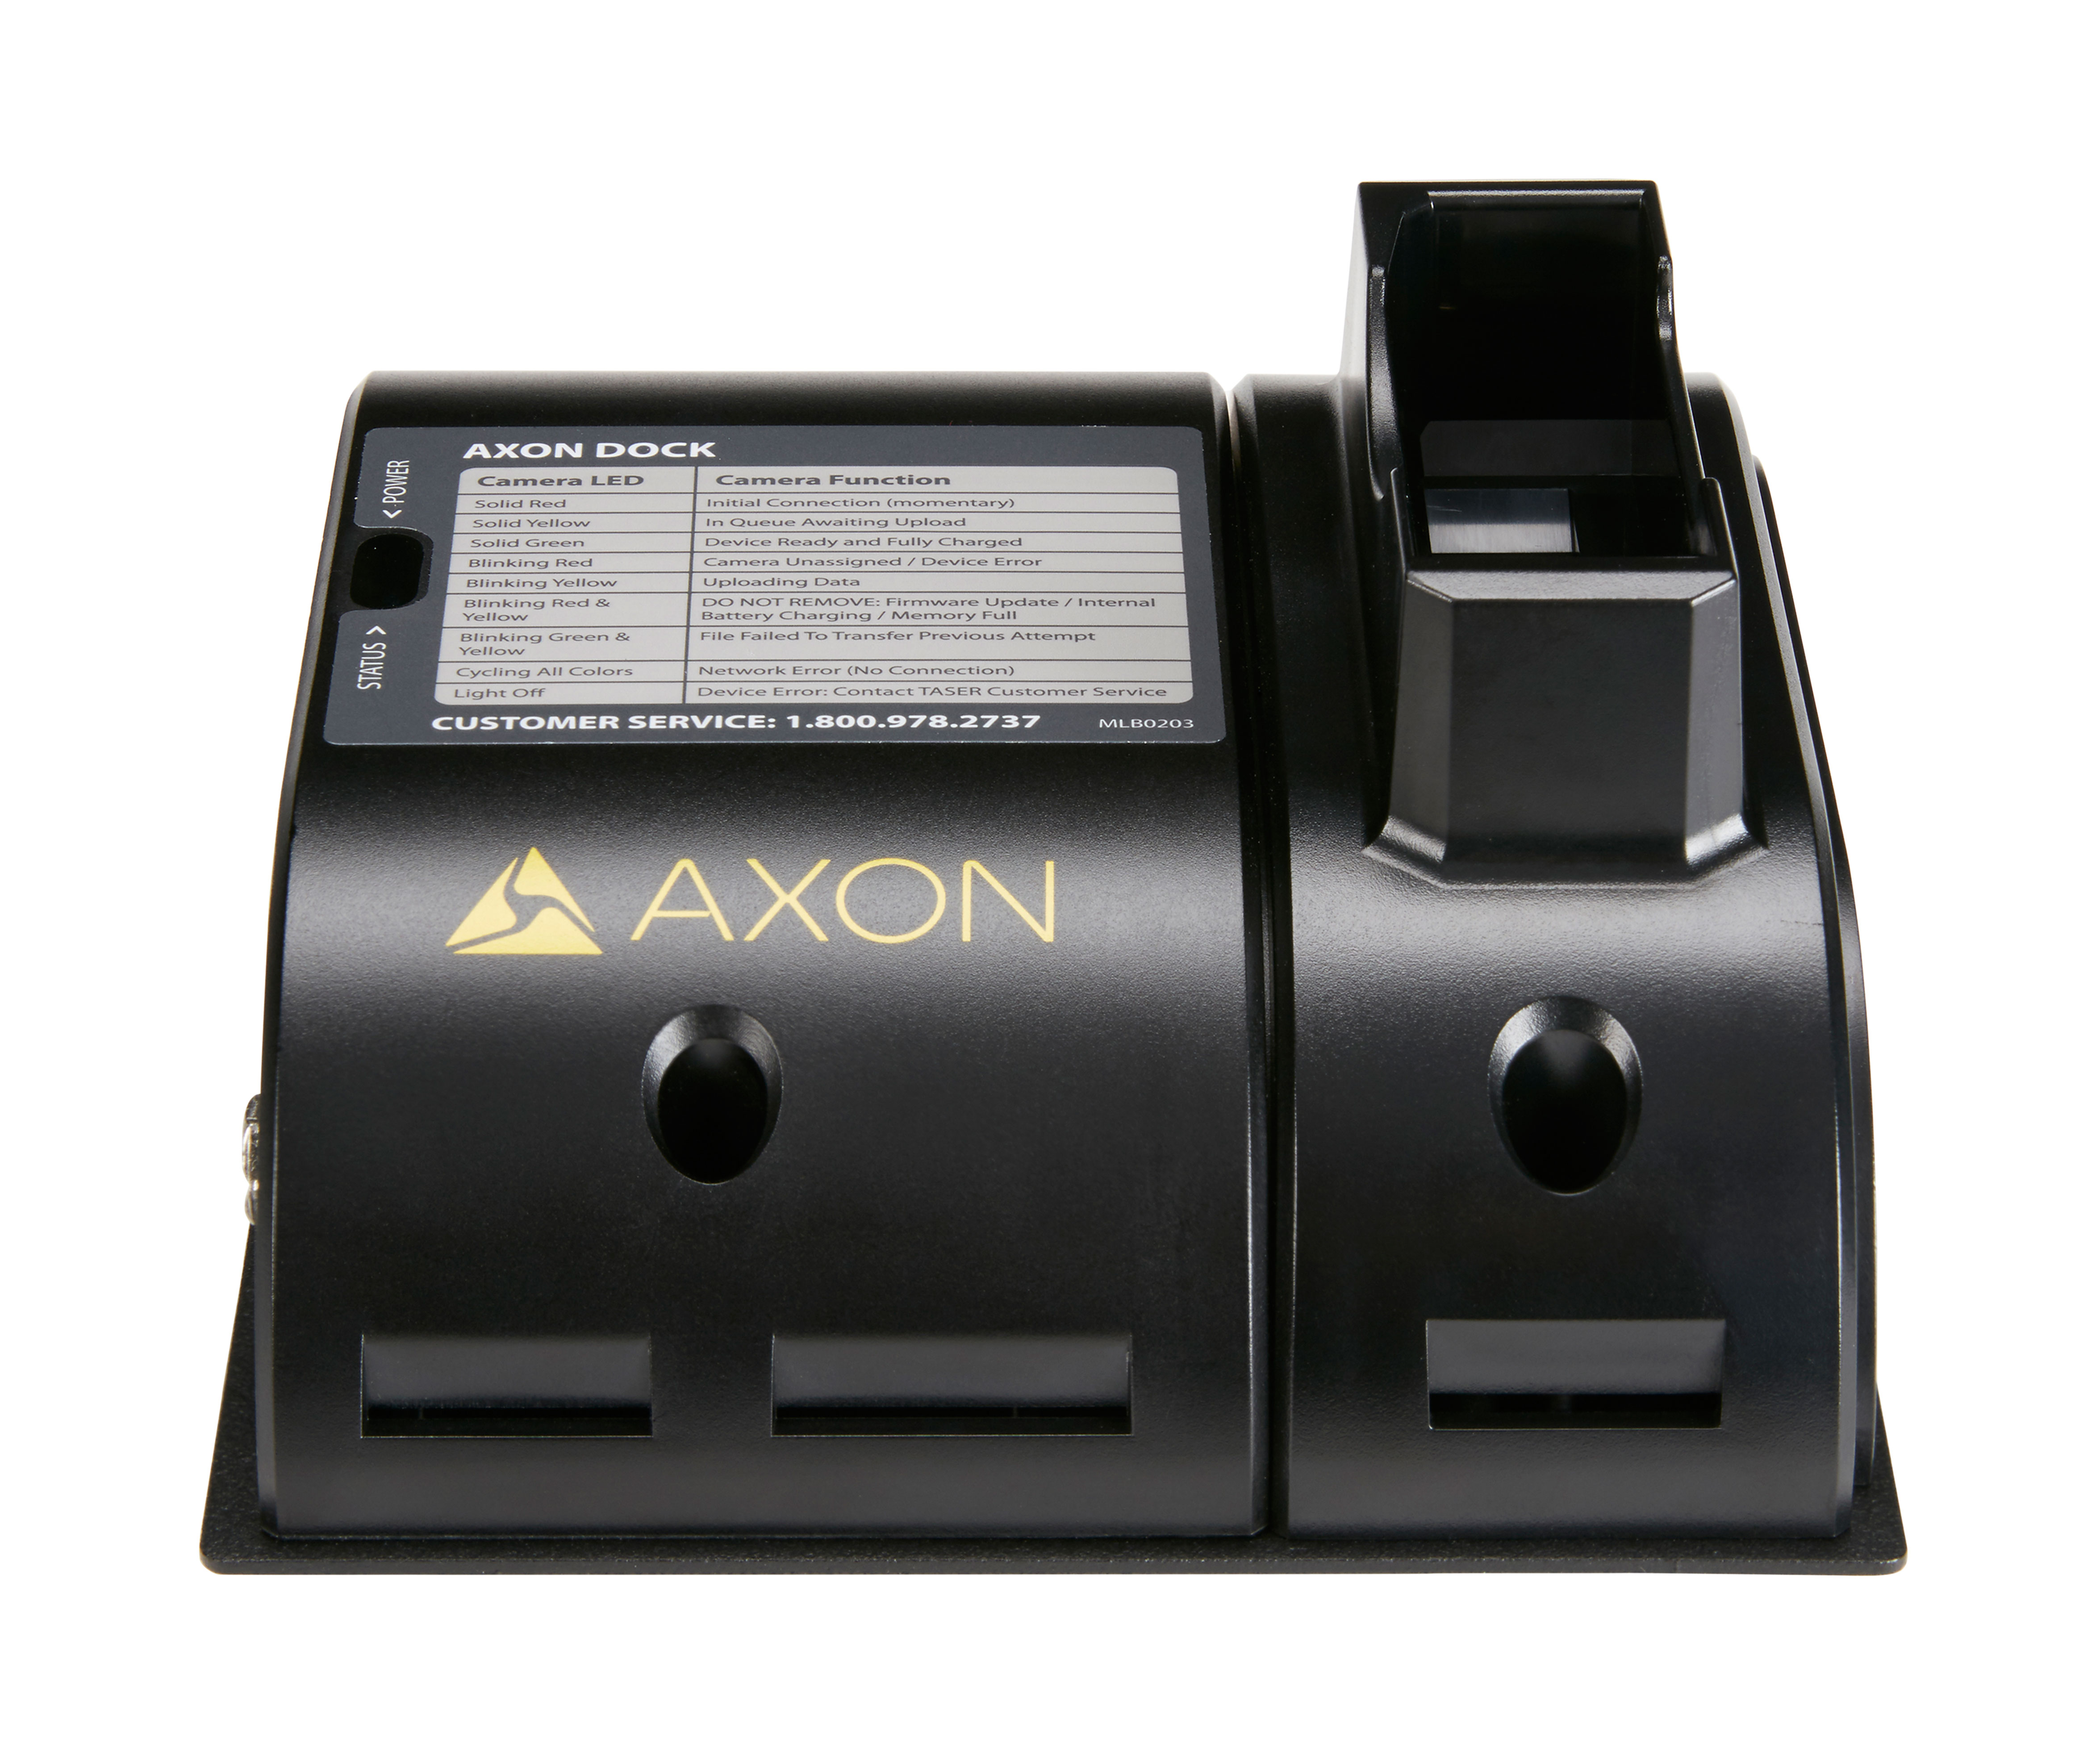
Docking & Charging the camera

Slide 18
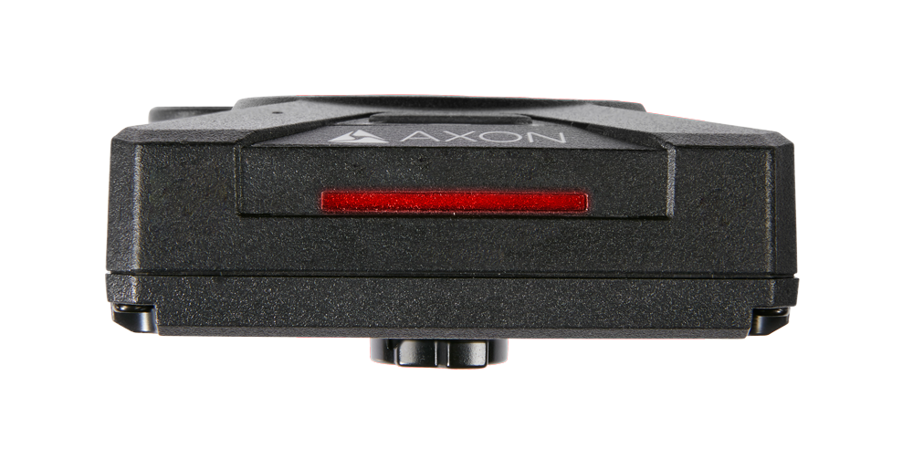
Camera LED information while on dock
Indicators during the upload process
Initial connection (momentary)
Solid red (for up to 20 seconds or fewer)
THIS IS NORMAL

Slide 19
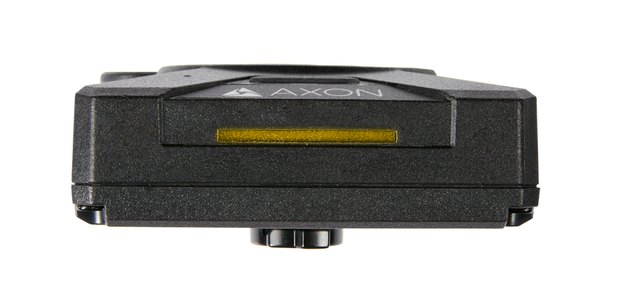
Camera LED information while on dock
Indicators during the upload process
In queue awaiting upload
Solid yellow
THIS IS NORMAL

Slide 20
Camera LED information while on dock
Indicators during the upload process
Uploading data
Blinking yellow
THIS IS GOOD

Slide 21
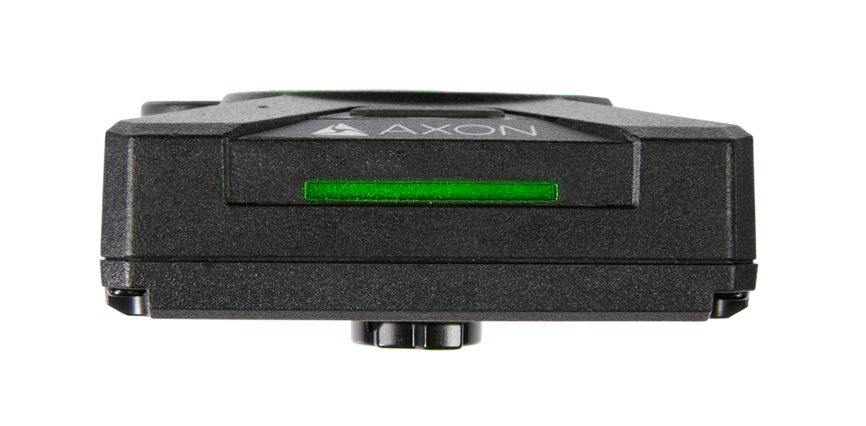
Camera LED information while on dock
Indicators during the upload process
Upload Complete
Solid green
DOES NOT ENSURE THE BATTERY IS FULLY CHARGED
JUST UPLOADED

Slide 22
Camera LED information while on dock
Indicators during the upload process
Device not assigned, agency mismatch,
camera set in the offline mode, or device error
Blinking red
CONTACT SNIDER IF YOU SEE THIS

Slide 23
Camera LED information while on dock
Indicators during the upload process
Firmware update, internal battery charging,
extremely low battery, or memory full
Blinking red and yellow
DO NOT REMOVE THE CAMERA

Slide 24
Camera LED information while on dock
Indicators during the upload process
Transfer error, device re-trying to transfer
or camera is left powered on when inserted
Blinking green and yellow
REMOVE THE CAMERA AND RE-INSERT IT

Slide 25
Camera LED information while on dock
Indicators during the upload process
Network error (no connection)
Blinking red, yellow, and then green (cycling all colors)
PLEASE NOTIFY SNIDER IF YOU SEE THIS

Slide 26
Camera LED information while on dock
Indicators during the upload process
Axon Dock has no communication with the camera
LED off
SEE IF THE DOCK HAS POWER

Slide 27
Pairing your axon body 2 device
Turn on the Axon Body 2 camera.

Slide 28
Pairing your axon body 2 device
Turn on the Axon Body 2 camera.
Hold down the Function and EVENT buttons for five seconds.

Slide 29
Pairing your axon body 2 device
Turn on the Axon Body 2 camera.
Hold down the Function and EVENT buttons for five seconds.
Wait until you hear four beeps. The Function LED and Operation LED will blink green.

Slide 30

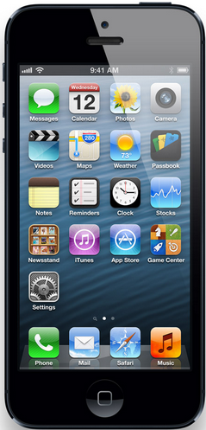


Axon view
Pairing with a Smart Device
Android
Apple iPhone
Notes:
Our application supports both Android and IOS based phones.

Slide 31
Axon view
Pairing with a Smart Device
Provides the following capabilities:
Pairs Axon cameras with Android or iOS devices
Instant replay
Live video streaming assists with optimal camera placement
GPS tagging maps video evidence automatically
Real-time metadata input enables searching and accurate retention

Slide 32
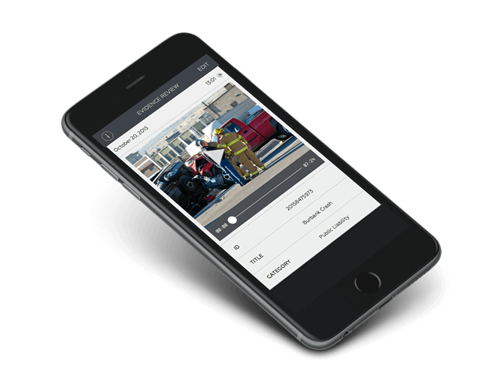
Live Preview – AXON view
Full, frame rate streaming and Wi-Fi capable.
There is only a 5 frame per second streaming bandwidth on Bluetooth.

Slide 33
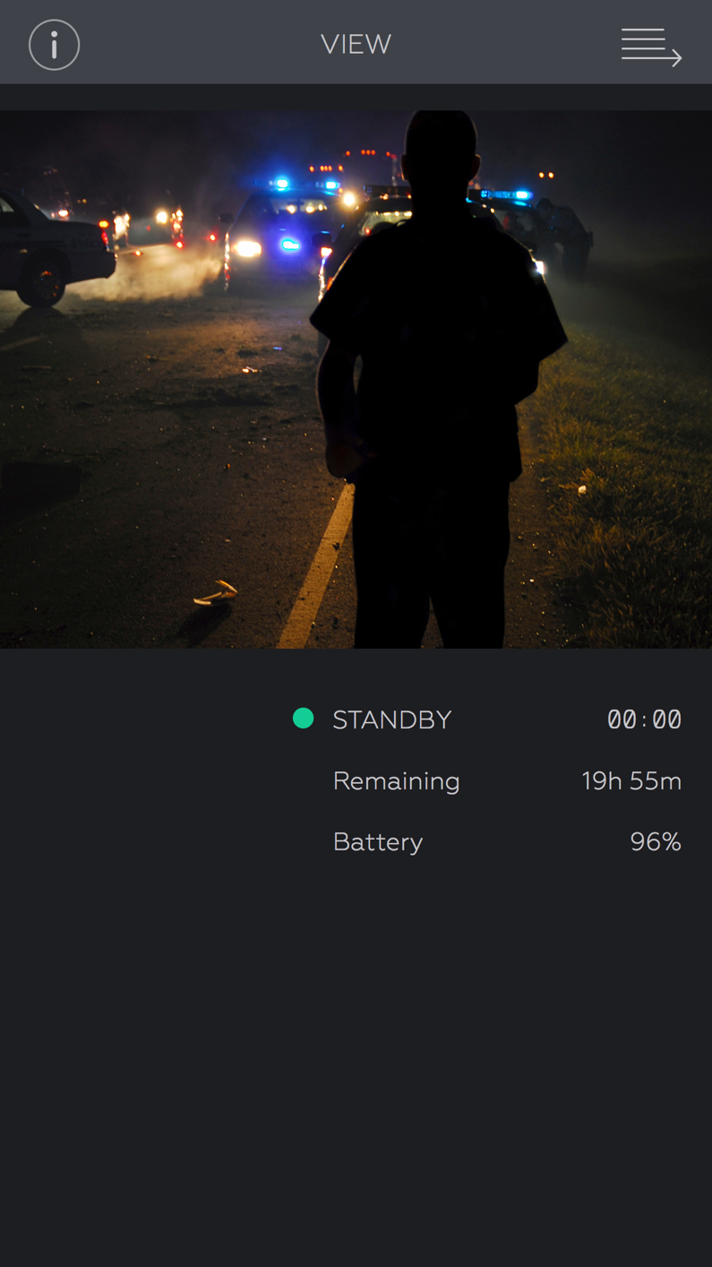
Camera Details – Axon view
The Camera Details tab includes:
Recording status
Remaining record time
Battery status
Notes:
This is the Camera Detail display. It will allow you to monitor you AXON Flex, and will describe its condition.

Slide 34
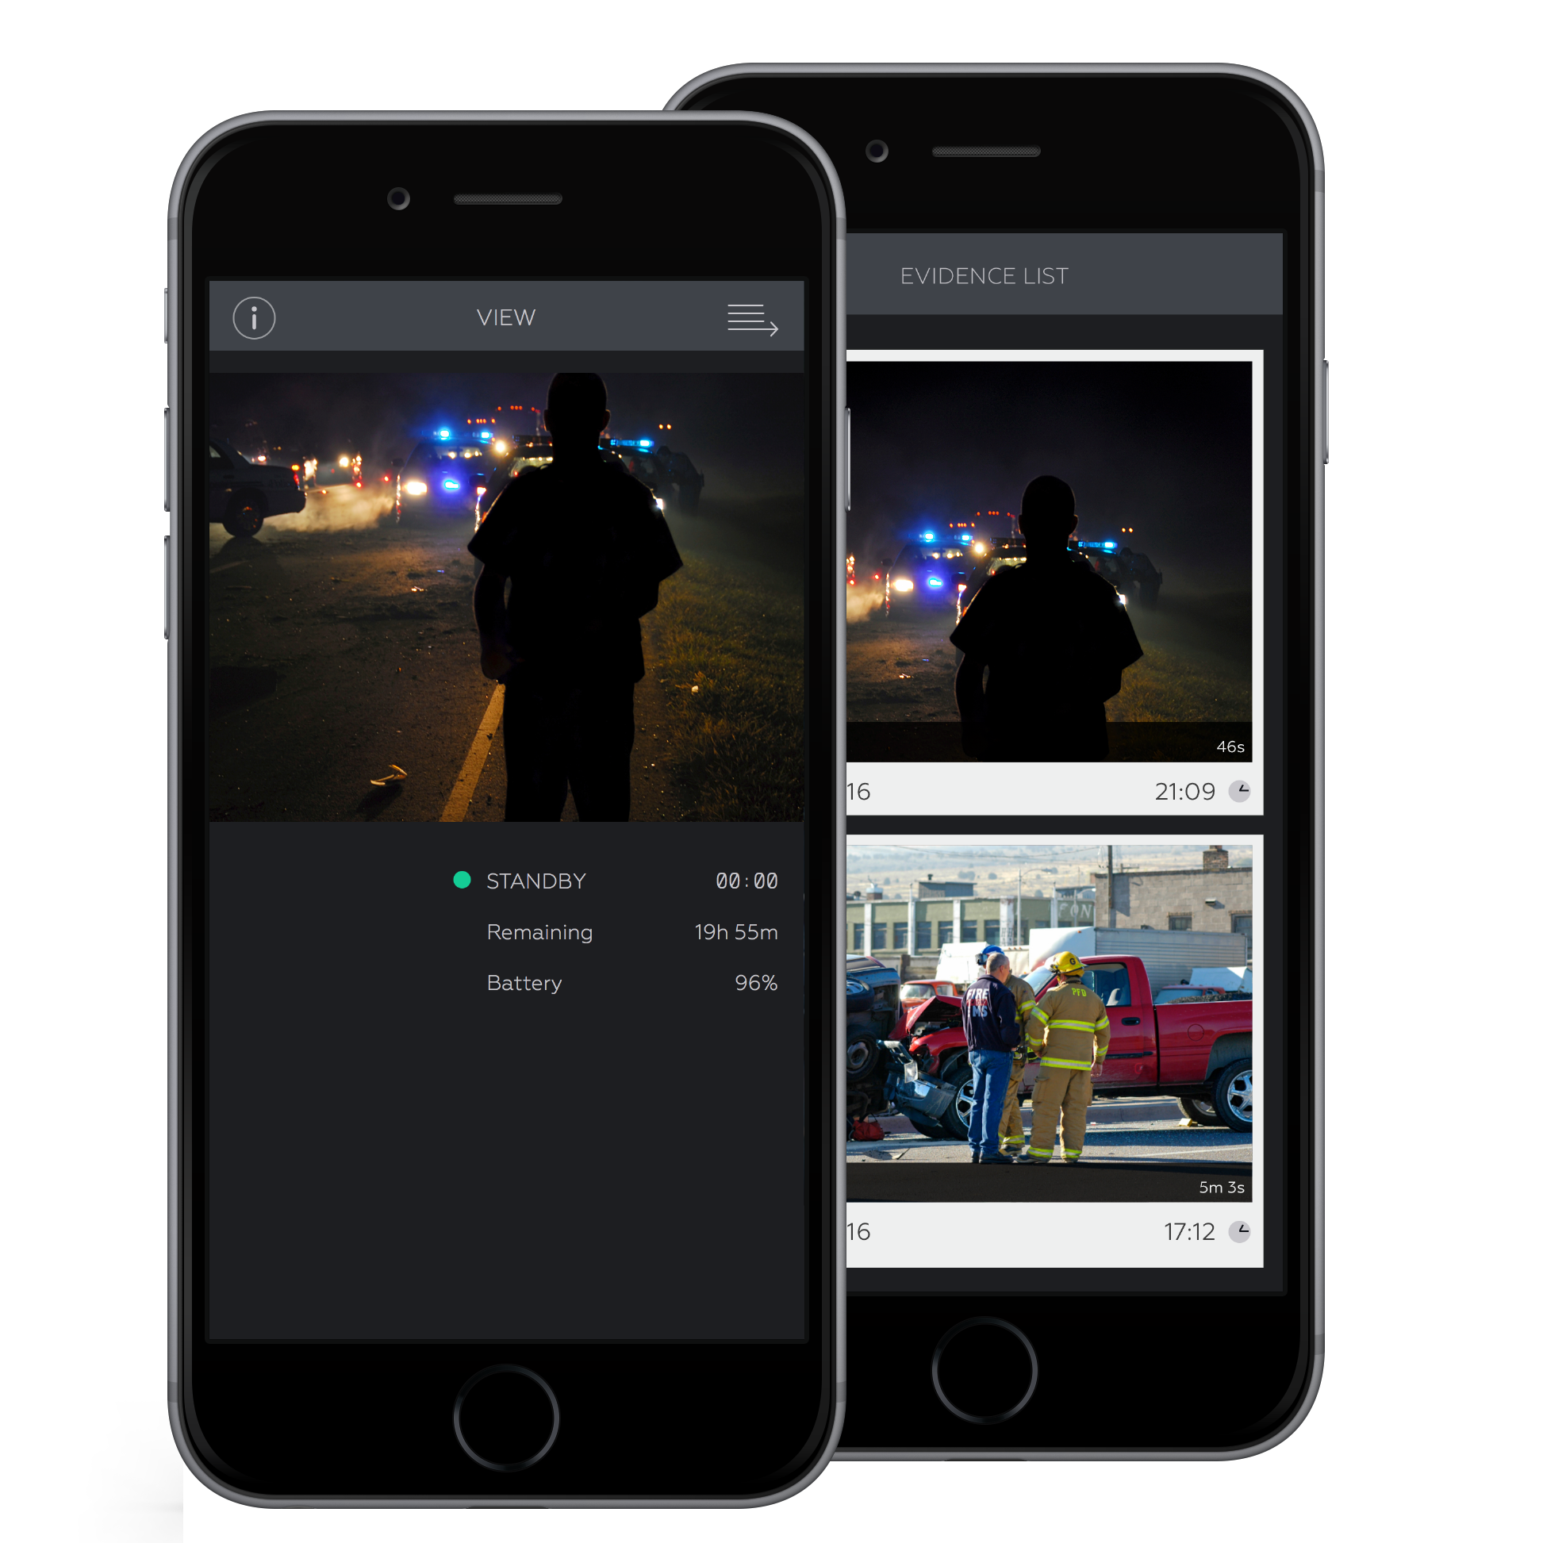
Metadata – Axon view
To add Metadata to a video, tap on the thumbnail of the video.
Once selected, there will be options to add/change ID, Title, and Category.
Notes:
To add Metadata or description to a specific video, select a video within the Evidence list. Underneath the video thumbnail, there will be 3 fields which can be edited.

Slide 35
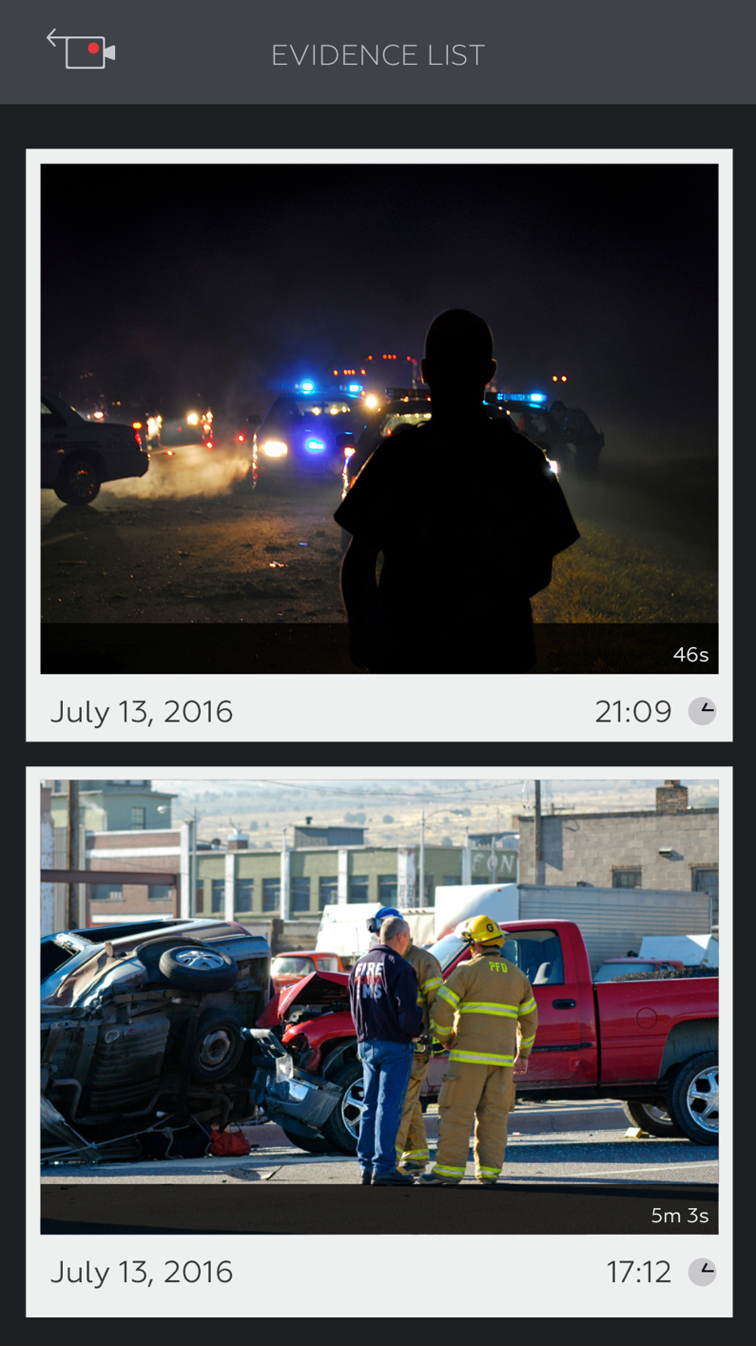
Evidence List – AXON view
To view recorded evidence, open the Axon View app and swipe left on the mobile device, or press the “arrow” icon in the upper right-hand corner.
To preview a specific video, tap on the appropriate thumbnail.
Notes:
A list of videos can be viewed after selecting the Evidence List tab.
Videos can be reviewed by selecting the a single video.

Slide 36
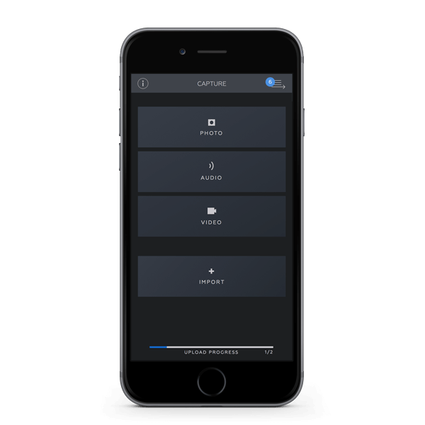
AXON capture
Captures digital evidence right from the field
Eliminates the needs to use alternative devices for photo, video, and audio recording
Ability to add metadata, title, and add GPS coordinates to any recording
Now has AXON Citizen*
Notes:
AXON Citizen added this year and available to be used.

Slide 37
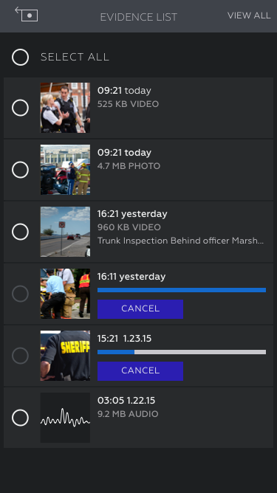
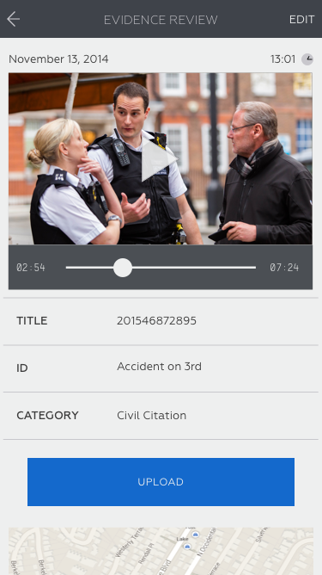
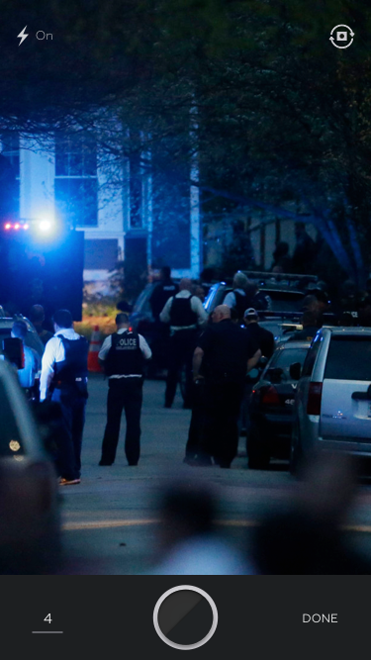
AXON capture

Slide 38
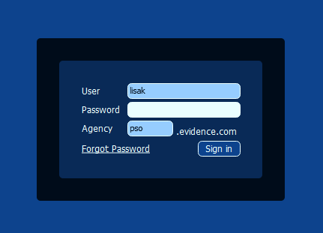
Log in - Evidence sync
Sign in to Evidence Sync using your Evidence.com credentials
Notes:
EVIDENCE Sync is software created by TASER International Inc.
Once the AXON Body camera is connected, click on the “DEVICE VIDEOS” tab. Their will be an option to upload all videos to the EVIDENCE.com services.

Slide 39
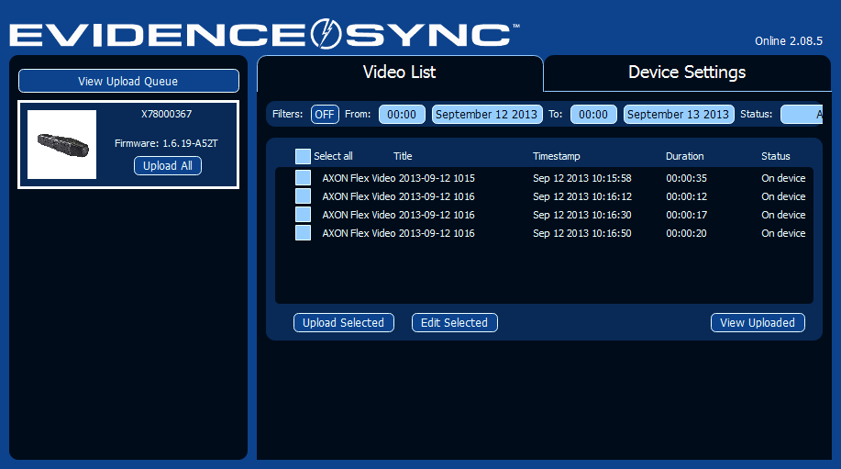
Evidence sync
EVIDENCE Sync software, allows you to upload all evidence using your computer to EVIDENCE.com.
Notes:
EVIDENCE Sync is software created by TASER International Inc.
Once the AXON Flex camera is connected, click on the “DEVICE VIDEOS” tab. Their will be an option to upload all videos to the EVIDENCE.com services.

Slide 40
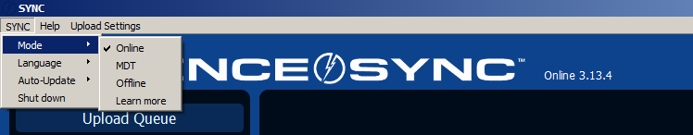
Modes - Evidence sync
Evidence Sync can be configured in three operating modes:
Online - Allows officers to view, add metadata and upload Axon videos to Evidence.com
MDT - Allows officers to view and add metadata to videos, but restricts uploading videos to Evidence.com
Offline - Allows officers to download videos to a desktop, but restricts adding metadata and uploading videos to Evidence.com
Notes:
EVIDENCE Sync is software created by TASER International Inc.
Once the AXON Flex camera is connected, click on the “DEVICE VIDEOS” tab. Their will be an option to upload all videos to the EVIDENCE.com services.

Slide 41
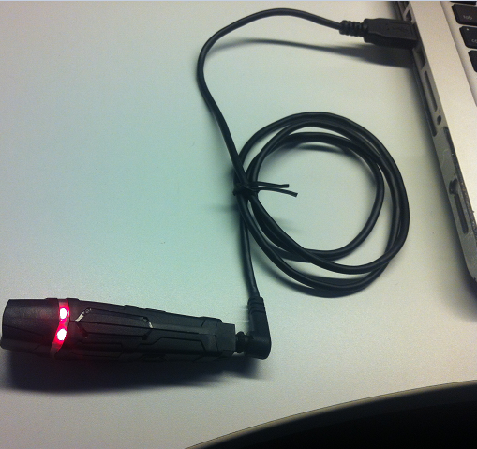
Connecting - Evidence sync
Plug the charging cable into the back of the camera
Connect the USB end into the USB port of your computer.

Slide 42
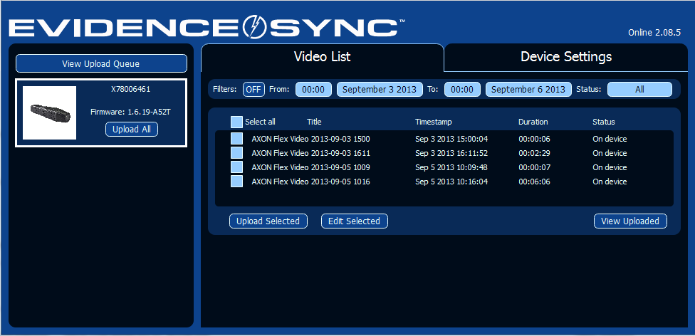
Reviewing videos - Evidence sync
After logging in, the home page will be visible.
From here, the Video List and Device Settings will be visible.

Slide 43
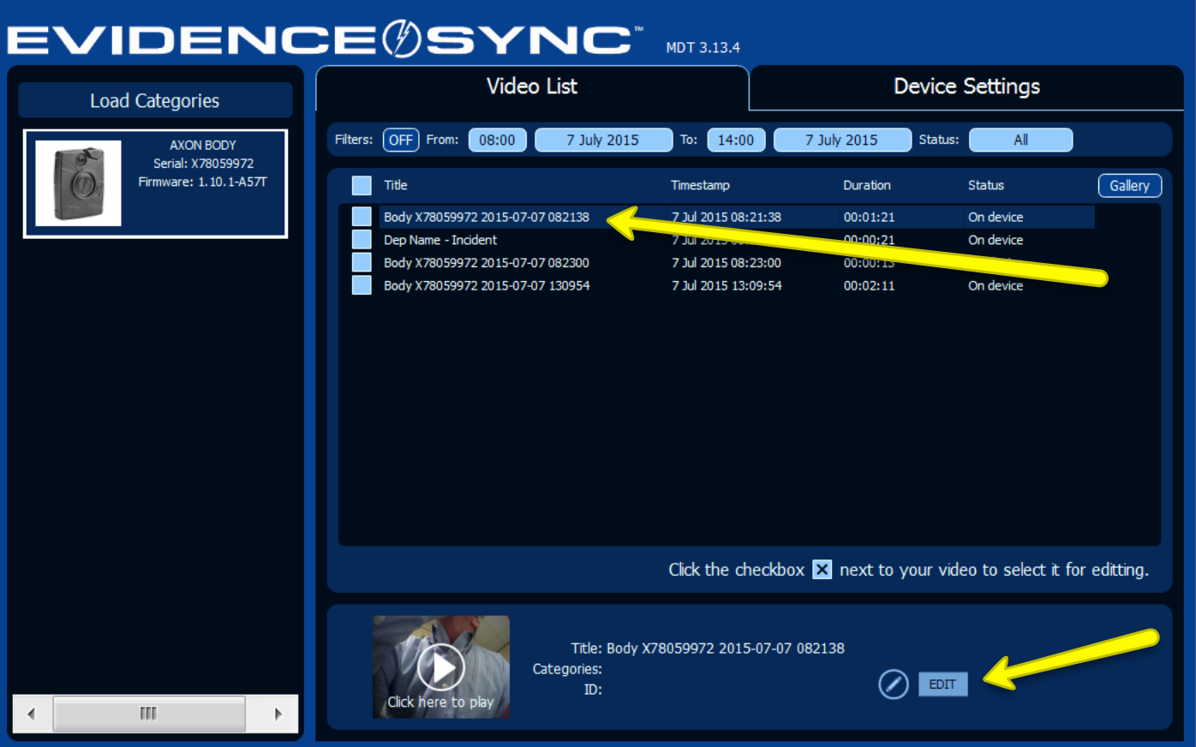
Playback Videos – evidence sync
Notes:
Playback – Select which video that you would like play back and select the play button on the bottom.
Edit – Allows the user to label the Title, ID, and Categories.
The DEVICE SETTINGS tab on the left of the screen will allow you to adjust the: Video quality, Microphone Capabilities, Orientation of the Flex, and Mode of usage.

Slide 44
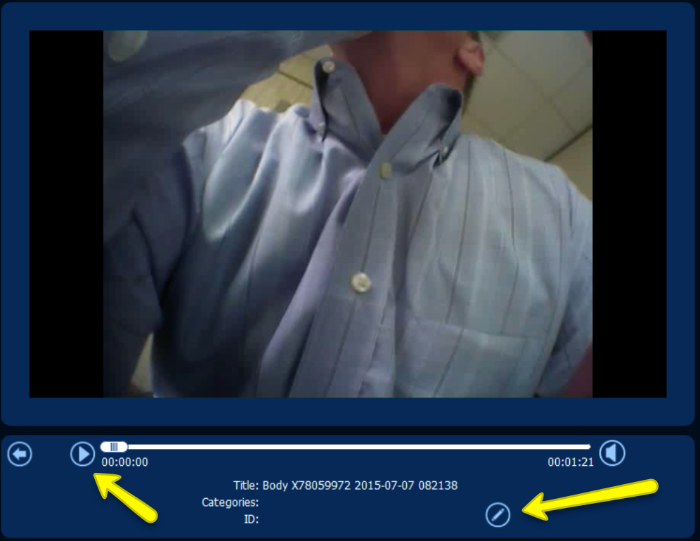
Playback Videos – evidence sync
Notes:
The DEVICE SETTINGS tab on the left of the screen will allow you to adjust the: Video quality, Microphone Capabilities, Orientation of the Flex, and Mode of usage.

Slide 45
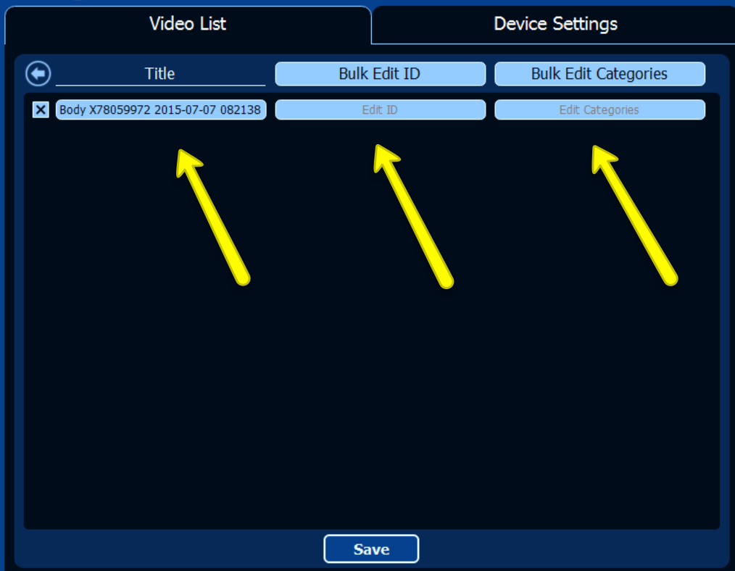
Playback Videos – evidence sync
Notes:
Title - Label to use for searching later in EVIDENCE.com.
ID – Usually is the Event Number / DR Number/ CAD Number/ Citation Number.
Categories – Defines what type of videos it is.

Slide 46
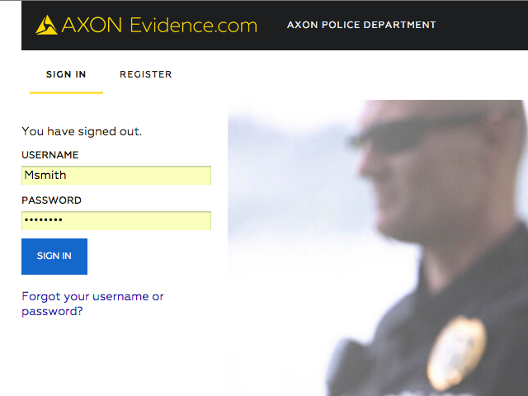
Agency.Evidence.com
Notes:
IF the environment lends itself to being able to display a live demonstration of the software.
Login
Dashboard Overview
Overview of categories
If you want to do away with the default category,
The most important category, is your most important category.
Most recent uploads
Here is the one from 2:00 that you wanted to view
Video Media Player
Explain the evidence details on the side
Based on the icons that you can see on the video media player, those are the capabilities of which you are permissioned to have access.
For example, if you want to share evidence, but you don’t see the icon for share evidence, you are not permissioned to do so.
Otherwise, if you see an icon, this means you have permission to use this tool in the media player.
Markers and Clips
Show redaction capabilities – but don’t go into this during user classes
Creating cases – are they going to be able to share with anyone or is this above their job? (in some agencies, this is just the role of the
Audit Trail

Slide 47
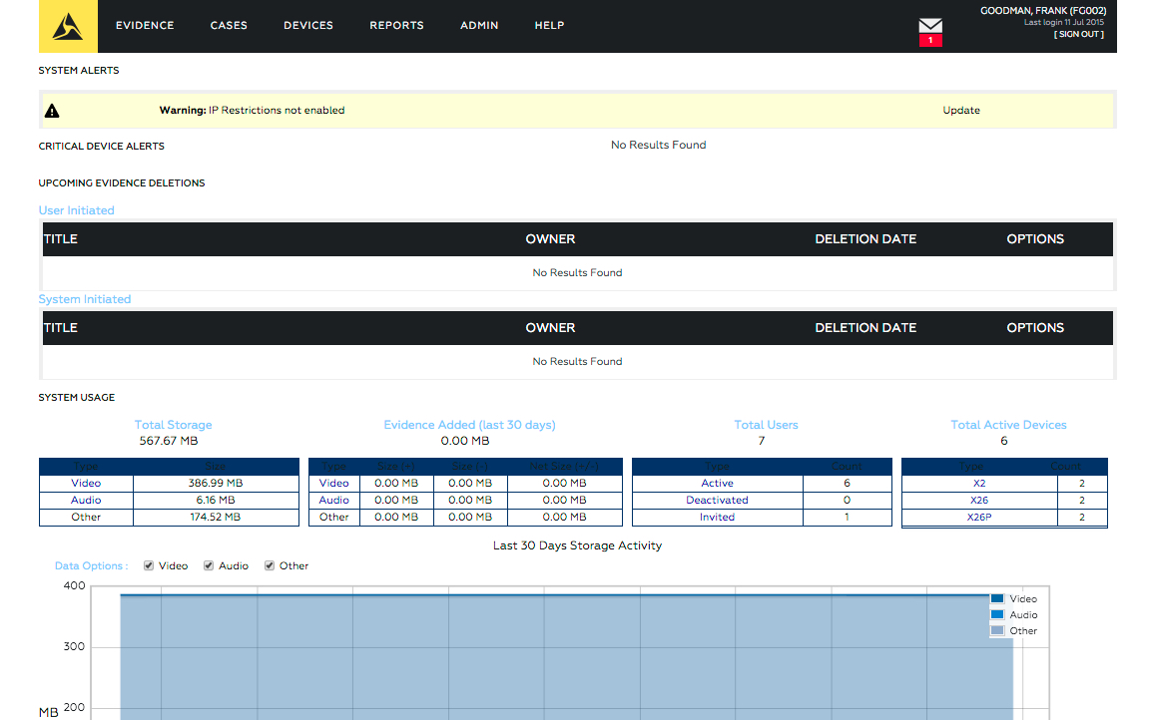
Dashboard

Slide 48
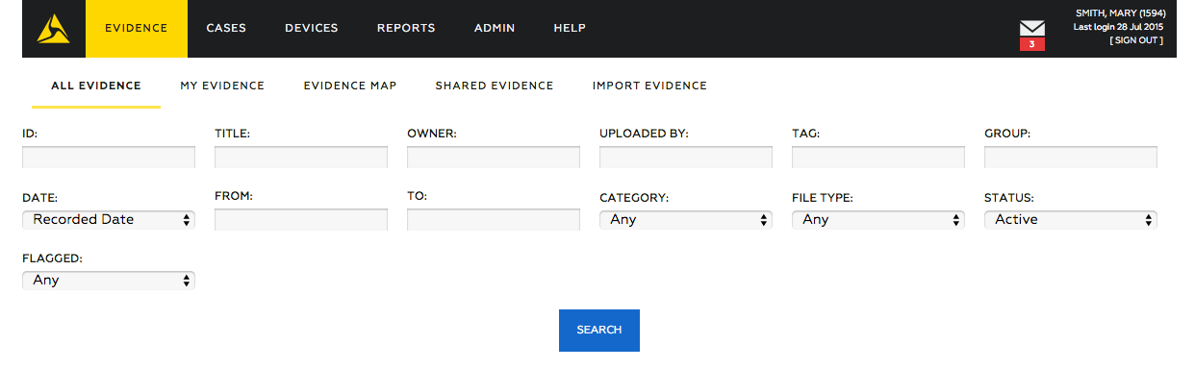
evidence
Evidence Tab Allows users to search through the Evidence database.
Filter Evidence Allows the user to filter down to a specific piece of evidence.

Slide 49
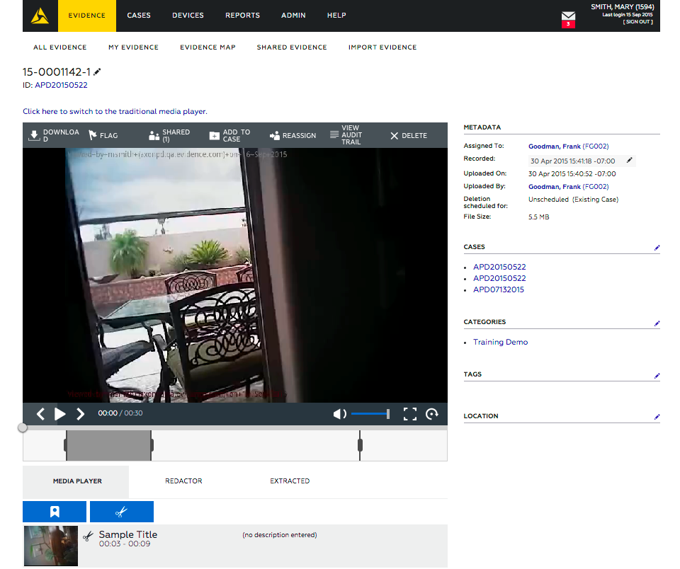
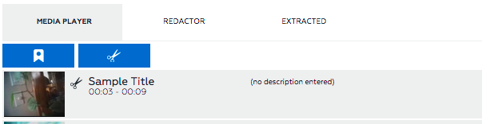
Tool: Add New Marker
Adding markers lets you highlight important moments and download screen shots.

Slide 50
Questions?

