Slide 1
Body Worn Cameras & Digital Evidence Management System
May 2014

Slide 2
Background
Without Body Worn Cameras
Others ARE recording
Key Events frequently missed
Situation may be misinterpreted

Slide 3
Background
Digital Evidence Management
CD/DVDs have a shelf life
Access control and tracking ability
One Place to store ALL types of digital evidence
Ease of providing D.A. access

Slide 4
Steps Involved
Market Research – Test Vendor selection
8 week trial period
End-User De-Brief
PSTC review of trial results and recommendation
5 year cost model
Draft policy development
Recommendation for purchase and deployment

Slide 5
Testing Summary
Four Cameras Tested
Taser Axon Flex
VieVu
MPH – Muvi
Wolfcom 3rd Eye
Two Digital Evidence Management Systems Tested
Evidence.com (by Taser)
Verpic Digital Evidence Management

Slide 6
Testing Outcome
By Surveys completed
Taser Axon and VieVu were on top
Evidence.com over VeripicDEM
By End-user Debrief
Taser Axon confirmed as preferred
Evidence.com confirmed as preferred

Slide 7
Recommendation
Taser Axon Flex
With optional variable mount kit
Evidence.com Digital Management System
Smartphone/Mini tablet for integration

Slide 8
Unique Strengths of package
Pre-record Buffer
Captures 30sec prior to record button
Flexible Application
Multiple mounting options
Record video, still photos & audio files
Seamless integration with handheld device

Slide 9
Unique Strengths of package
Cost & time savings
Ability to categorize files on the fly
No need to wait for end of shift
Docking Station
Drop it off and walk away
Files already tagged/categorized via hand held device

Slide 10
Cost Analysis
Start up & Five year models
Included assumptions:
Repair needs
Number of users accessing system
Data storage costs

Slide 11
Costs Analysis
Estimated Total Start-up costs
$308,451
Estimated Total 5 year Costs
Including start-up & 1 replacement of all units at year 2.5
$781,014

Slide 12
Installation Timeline
Two options
Partial rollout & Full rollout
Due to need for critical infrastructure upgrades to the PD’s network

Slide 13
Installation Timeline
Partial Rollout
Phased in over ~7 months
First three months
25 cameras, 25 user accounts, 5 docks
User training for upload docks installation
SDU, SRO, Traffic, K9, Limited Patrol Teams

Slide 14
Installation Timeline
Partial Rollout
Subsequent months
High cap network upgrade (CIP dependent)
Data Room built
Order additional cameras and equipment
User Training
Deployment
Program fine-tuning

Slide 15
Installation Timeline
Full Rollout
Timeline contingent on:
Network upgrades
Data room build
Order all at once ~150 units
User training
Deployment

Slide 16
Questions?

Slide 17
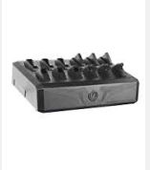
Docking station

Slide 18
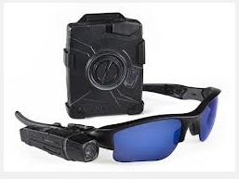

Axon Camera

Slide 19
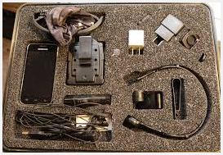
Variable Mount Kit

