Slide 1
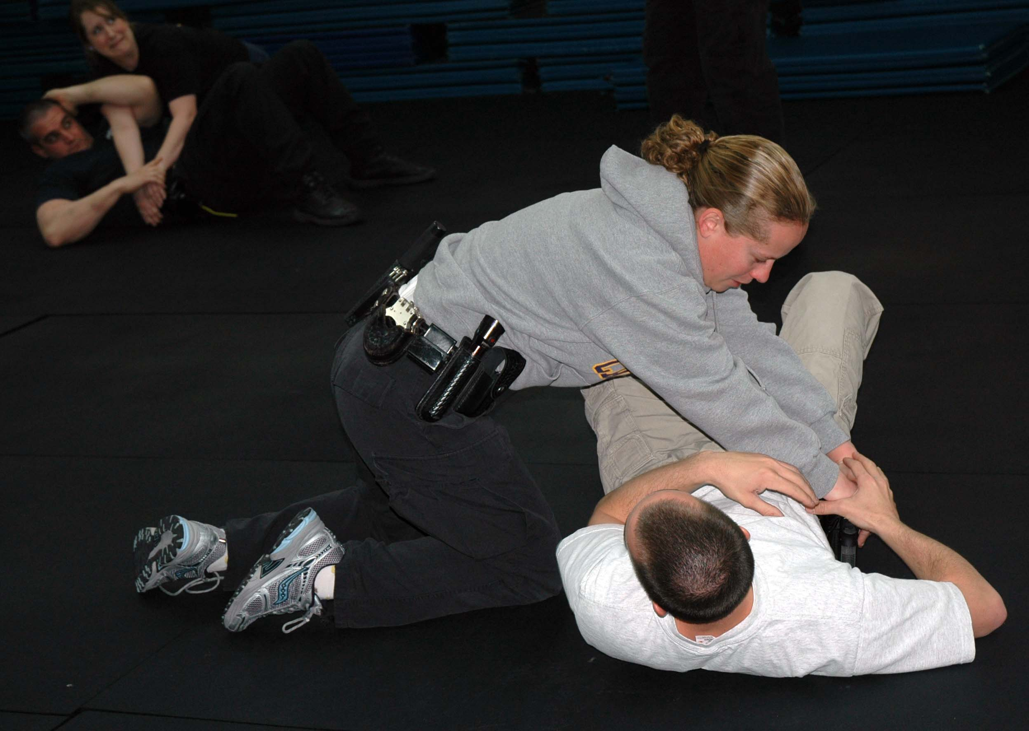

Subject Control Arrest Techniques: Ground Fighting

Slide 2
TRAINING OBJECTIVES
Examine the force option concept.
Critique the concepts of reasonableness and perception as they relate to force option selection.
Differentiate the differences between less lethal and lethal force options.

Slide 3
TRAINING OBJECTIVES
Demonstrate the following control techniques:
a. Tackle Block
b. Wrist Wrap/Defeating the Grab
Guard Position (closed)
d. Straight Arm Bar
e. Single Leg Takedown
f. Blocking from the Ground
g. Side Control
h. Side Control to Handcuff

Slide 4
TRAINING OBJECTIVES
Demonstrate the following escape techniques:
a. Escape from Mount Position
b. Guard-to-Stand
c. Break “bear hugs” from a variety of positions
d. Break guillotine chokes from a standing and a suspect’s guard position

Slide 5
TRAINING OBJECTIVES
Demonstrate the following weapon retention techniques:
a. Arm Bar from the Guard
b. Retention from Full Mount
c. Retention from Side-Mount (non-gun side)
d. Retention from Side-Mount (gun side)

Slide 6
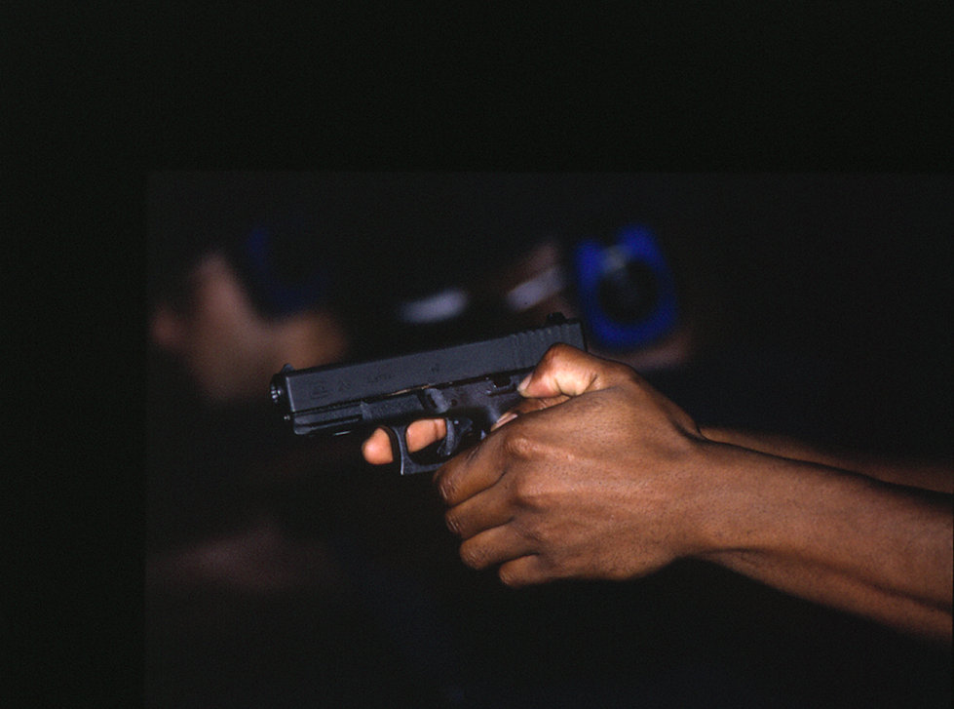
USE OF FORCE
“The amount of force required by police to compel compliance by an unwilling subject.”
International Association of Chiefs of Police (IACP)

Slide 7
LESS LETHAL FORCE
To prevent the escape from custody or to effect an arrest of a person who he reasonably believes has committed a criminal offense, unless he knows that the arrest is unauthorized; or
To defend himself or a third person from what he reasonably believes to be the use or imminent use of physical force while effecting or attempting to effect an arrest or while preventing or attempting to prevent an escape.
N.C.G.S. 15A-401

Slide 8
LETHAL FORCE
To defend himself or a third person from what he reasonably believes to be the use or imminent use of deadly physical force;
To effect an arrest or to prevent the escape from custody of a person who he reasonably believes is attempting to escape by means of a deadly weapon, or who by his conduct or any other means indicates that he presents an imminent threat of death or serious physical injury to others unless apprehended without delay;
To prevent the escape of a person from custody imposed upon him as a result of conviction of a felony.

Slide 9
Reasonableness…Graham v. Connor
“The test of reasonableness under the 4th Amendment is not capable of a precise definition or mechanical application ... Its proper application requires careful attention to the facts of each particular case…”
Reasonableness judged from perspective of a reasonable officer at the scene
Decisions based on “totality of the circumstances” and how they are evolving
Requires sound decision making and an understanding of force options.

Slide 10
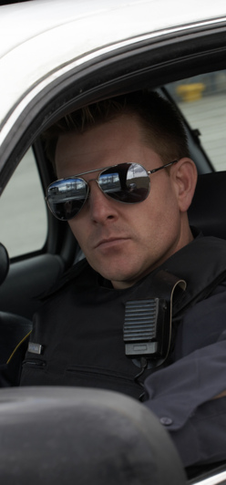
Perception
Individual officer’s perception is critical
Must look at “totality” and continually assess, plan, and act
One officer may perceive a threat while another may not during the same incident, due to any number of factors

Slide 11
Perception
Must place ourselves in the position of the officer at the moment of decision
Reasonableness is not determined by a particular force option(s), but rather the “totality” that forced the decision

Slide 12
Elements of Objective Reasonableness
Ability/Capability of a subject to carry out the threat - must be a logical perception.
Opportunity indicates that the action or threat perceived by the officer is imminent. The subject must be in a position to carry out the threat.
Intent is initiating an overt act in furtherance of a threat - “demonstrated intent.”

Slide 13
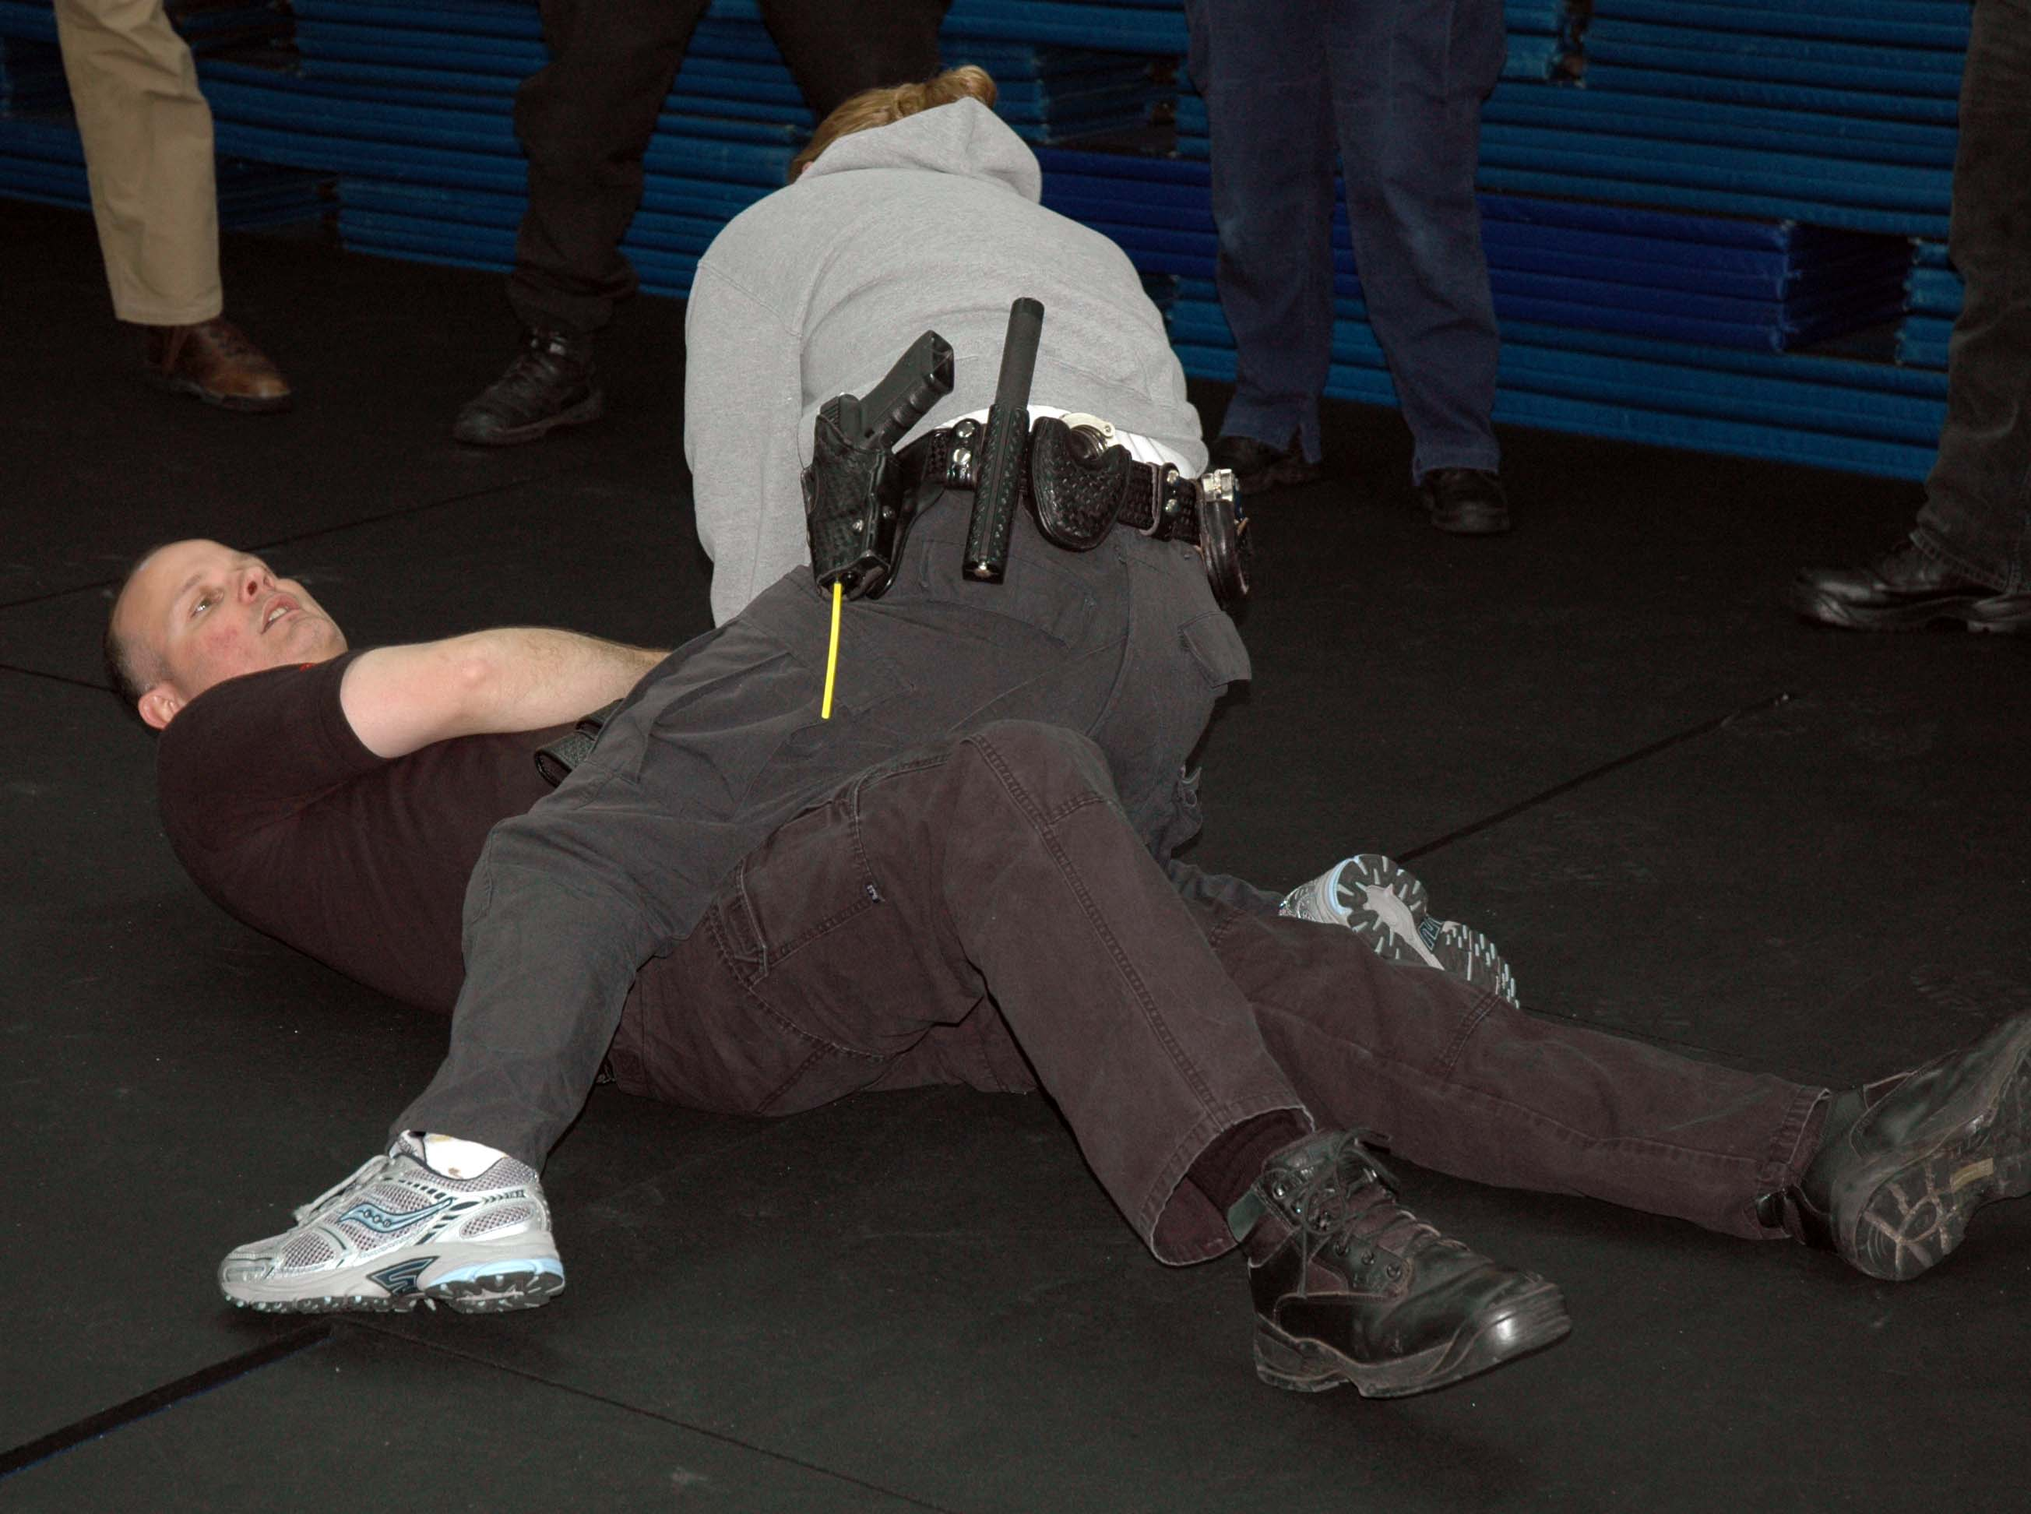
Principles
Officers must be 100% committed once the decision to use force has been made - a failed technique is much less likely to work a second time.
Anticipate that one technique will not control; work in combinations; have a follow-up plan.
The primary objective is quick, effective control. The longer the confrontation, the more danger!
Once control is established, force must be reduced to a level needed to maintain the control.

Slide 14
O
P
T
I
O
N
S
F
O
R
C
E

Slide 15

CONTROL LEVELS
Presence
Verbal Direction/Control
Physical Control
Aerosol/Chemical Agent
Electronic Impulse Device
Intermediate Weapon
Lethal Force

Slide 16
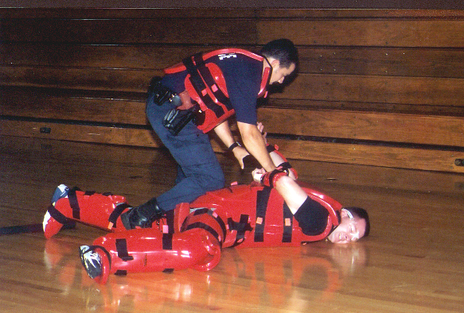
Force Variables
Subject behavior
Totality of circumstances
Environmental conditions
Reaction time/distance
Multiple subjects/officers
Size and gender
Skill level of officer
Apparent skill level of suspect
Age of subject/officer
Injury or exhaustion
Weapon availability
Other alternatives
Previous knowledge of subject

Slide 17

RESISTANCE LEVELS
National Institute for Justice (1997) study - six agencies and approximately 7,500 arrest situations were analyzed:
Most common (non-weapon) type of resistance - wrestling, followed by pushing/shoving
Most common force (non-weapon) option - grabbing followed by wrestling
Knife most common weapon
Most common force option - chemical agent, followed by flashlight

Slide 18
Statistics
A survey conducted by Calibre Press and PPCT of 1000+ law enforcement officers from federal, state, and local agencies as to circumstances surrounding ground attacks found that:
52% reported an attempted take-down with
60% of attempts being successful
64% continued to attack
21% attempted a disarm – 5% successful
13% of the time – multiple attackers
95% of officers used non-lethal force
Officers injured 26% of the time
Most often took place during field interviews;
second most often was during handcuffing

Slide 19
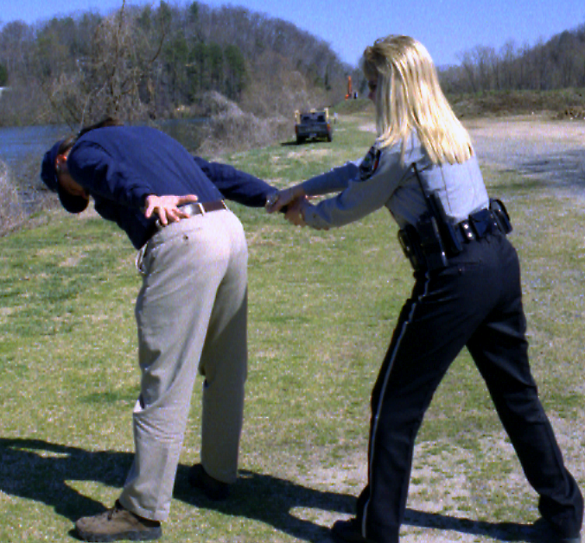

“You will need a combat mind-set, or else all of your techniques will fail.” – Ricardo Murgel

Slide 20
TRAINING OBJECTIVES
Examine the force option concept.
Critique the concepts of reasonableness and perception as they relate to force option selection.
Differentiate the differences between less lethal and lethal force options.

Slide 21
TRAINING OBJECTIVES
Demonstrate the following control techniques:
a. Tackle Block
b. Wrist Wrap/Defeating the Grab
Guard Position (closed)
d. Straight Arm Bar
e. Single Leg Takedown
f. Blocking from the Ground
g. Side Control
h. Side Control to Handcuff

Slide 22
TRAINING OBJECTIVES
Demonstrate the following escape techniques:
a. Escape from Mount Position
b. Guard-to-Stand
c. Break “bear hugs” from a variety of positions
d. Break guillotine chokes from a standing and a suspect’s guard position

Slide 23
TRAINING OBJECTIVES
Demonstrate the following weapon retention techniques:
a. Arm Bar from the Guard
b. Retention from Full Mount
c. Retention from Side-Mount (non-gun side)
d. Retention from Side-Mount (gun side)

Slide 24

Questions?
Questions?
Questions?
Questions?
Questions?

